Slide 1
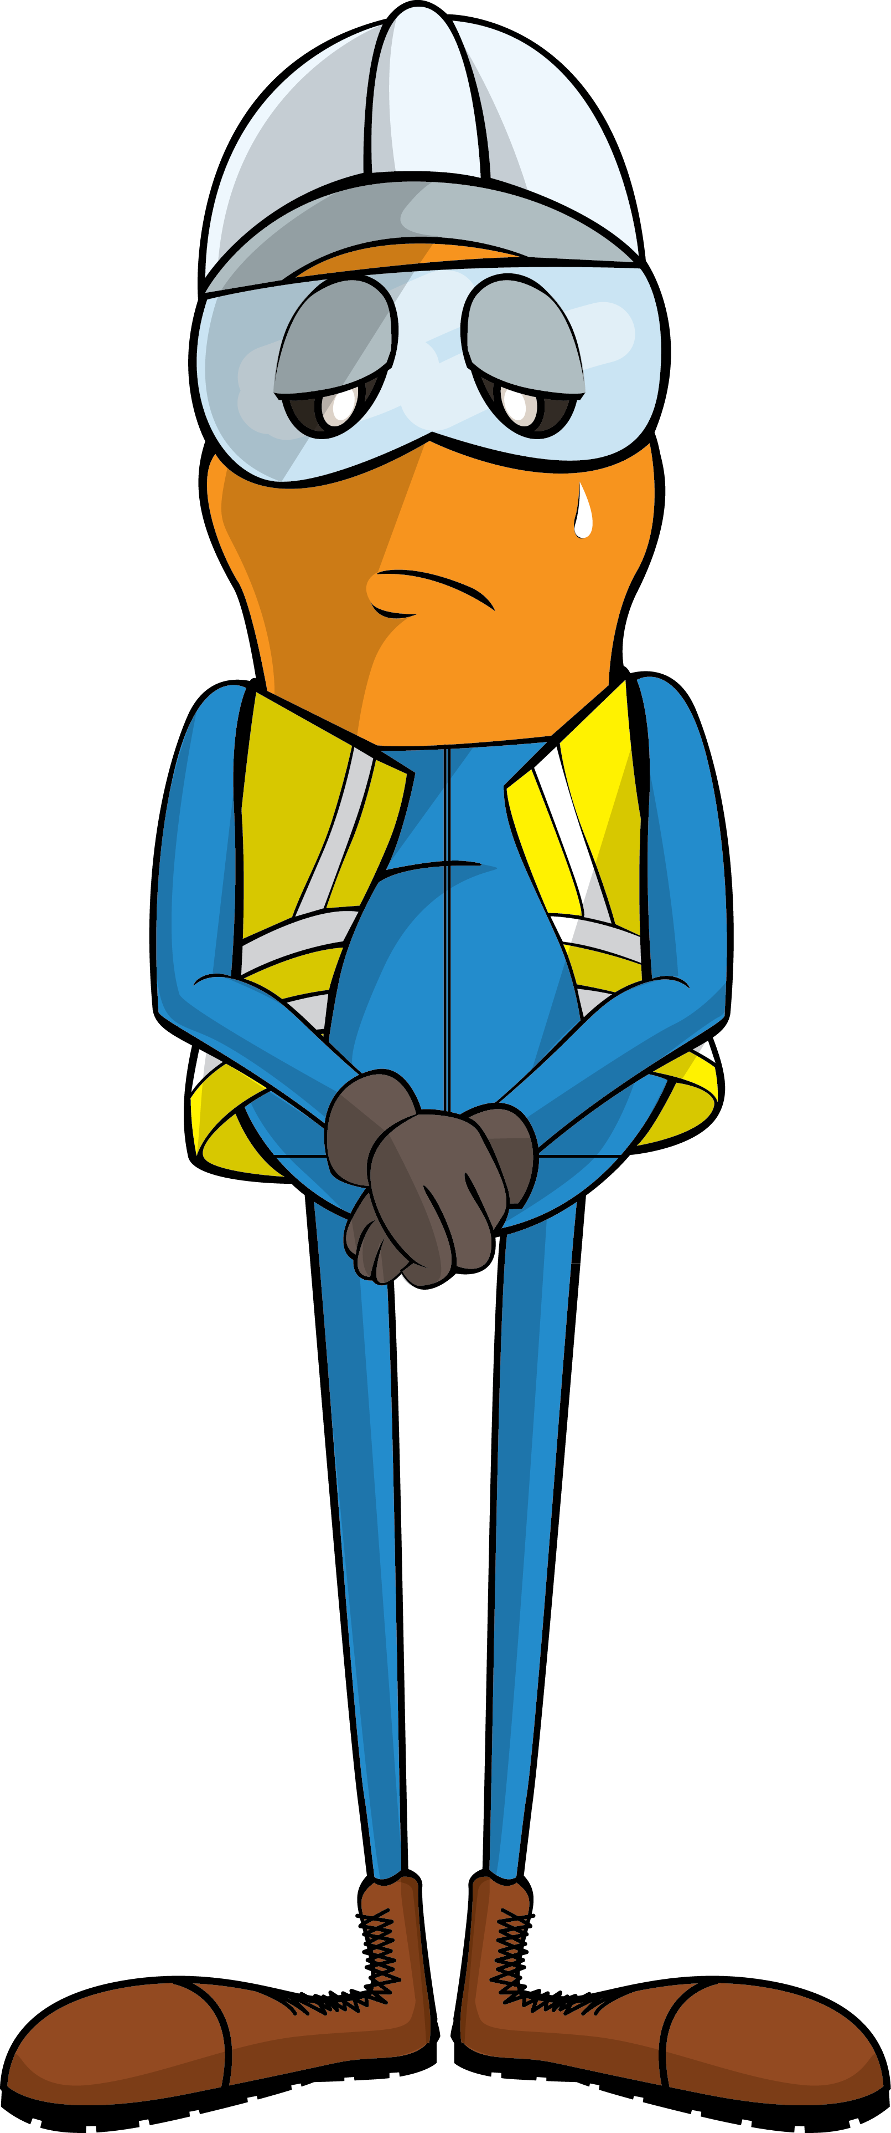
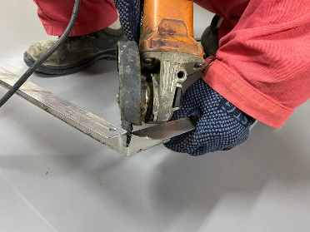
PDO Incident First Alert
Incident Type | LTI#16 | Pattern | Release energy
Date / Time | 21.08.2020@10:30hrs | Directorate
Location | Bahja | Dept
Target Audience
Drilling, Operations, Engineering, Construction & Logistics
What happened
While the Carpenter was trying to cut the frame using angle grinder in a sitting position, the grinder slipped and moved towards him causing a serious injury in his groin area.
Mr. Musleh asks the questions of can it happen to you?
Do you ensure you identify all hazards before starting a task?
Do you ensure you are in a safe position while performing a task?
Do you consider your body is out of line of fire while using hand powered tool?
How do you ensure hand powered tool operators are competent?
Carpenter using grinder
Please disseminate this LTI notification to your teams and use it in your tool box talks and HSE meetings and notice boards.

