Slide 1
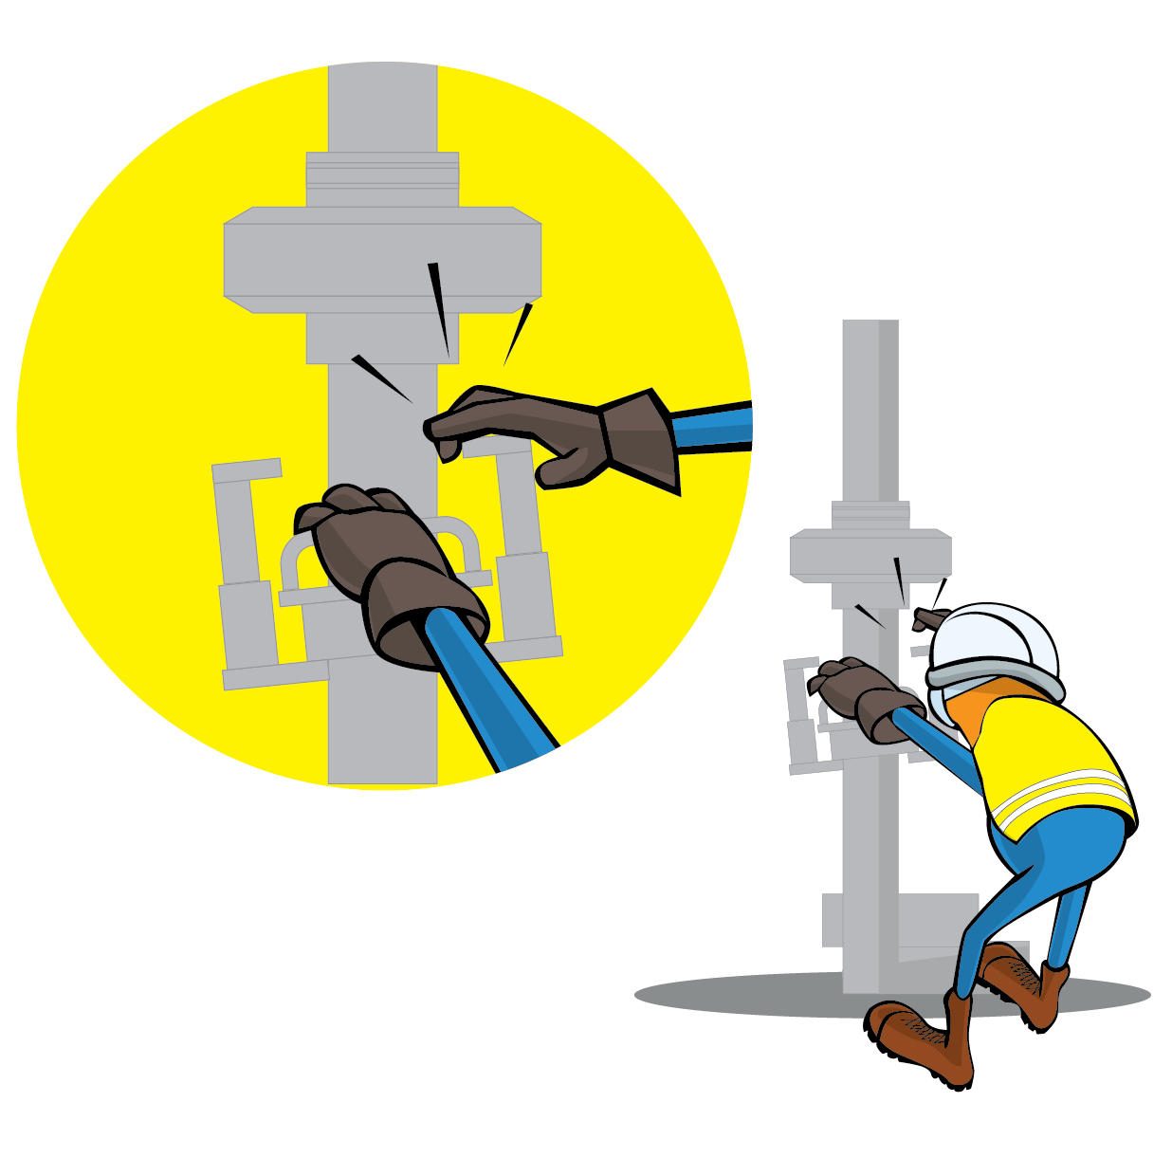
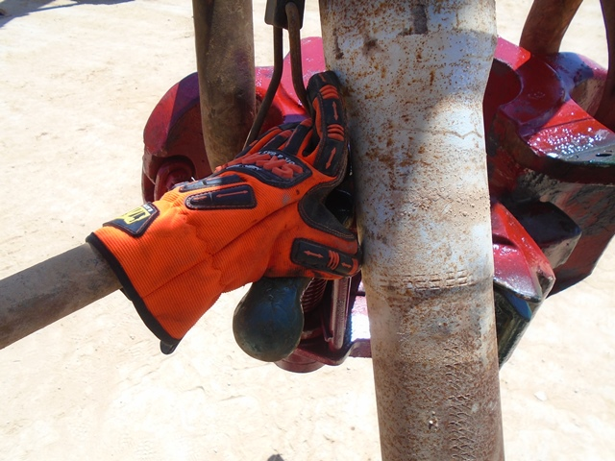
PDO Incident First Alert
Incident Type | LTI#17 | Pattern | Hands & Finger
Date / Time | 29.08.2020@03:24hrs | Directorate
Location | Rima | Dept
Target Audience
Drilling, Operations, Engineering, Construction & Logistics
What happened
While Derrickman was latching the pipe to the elevator, his right hand got trapped between the drill pipe and the elevator caused crush injury to his right little finger.
Mr. Musleh asks the questions of can it happen to you?
Do you ensure you identify all hazards before starting a task?
Do you always use the handles provided?
Do you ensure you keep your hands away of crush points “Line of Fire”?
Crush point
Please disseminate this LTI notification to your teams and use it in your tool box talks and HSE meetings and notice boards.

