Slide 1
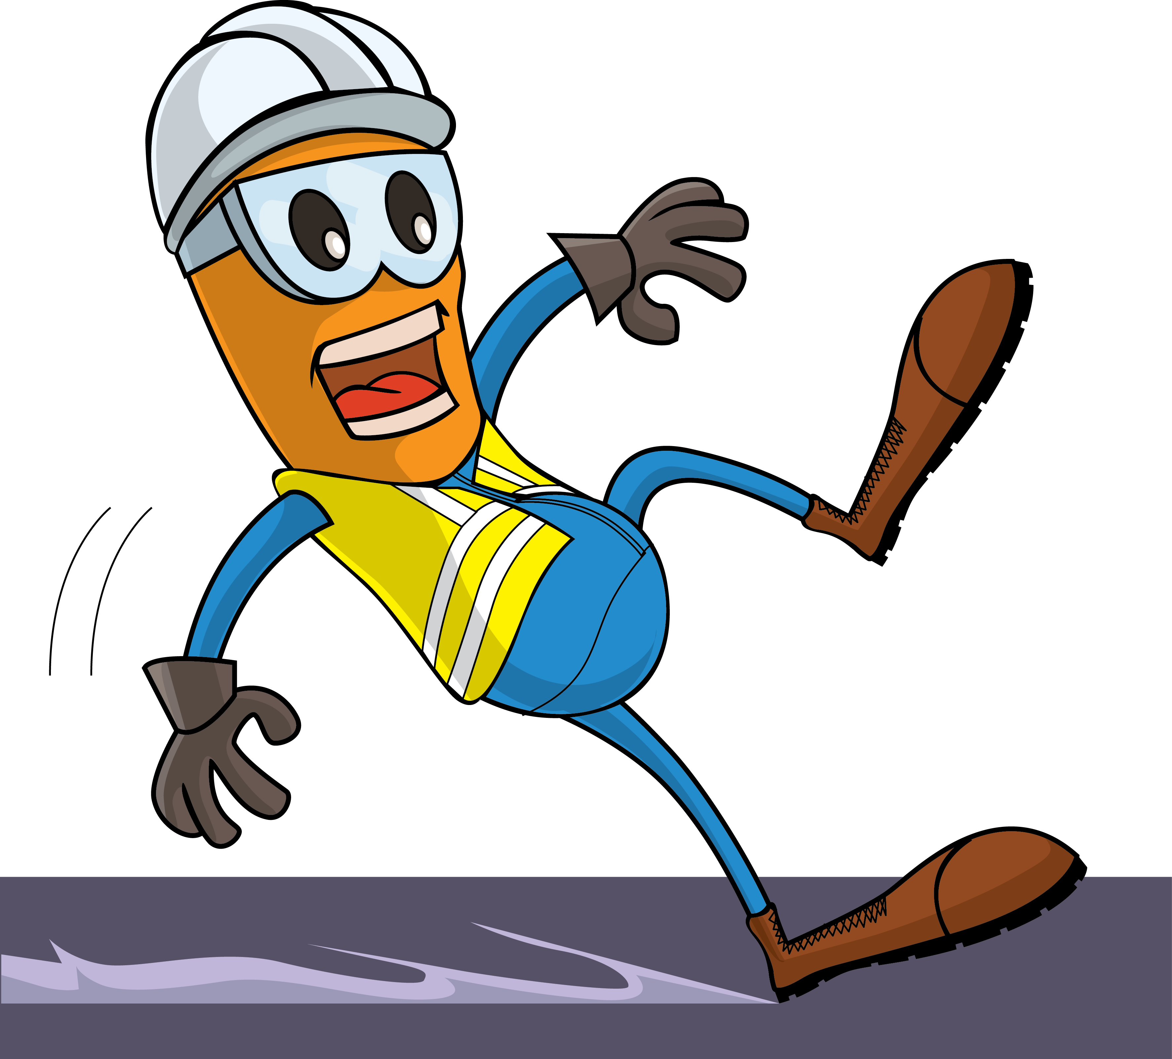
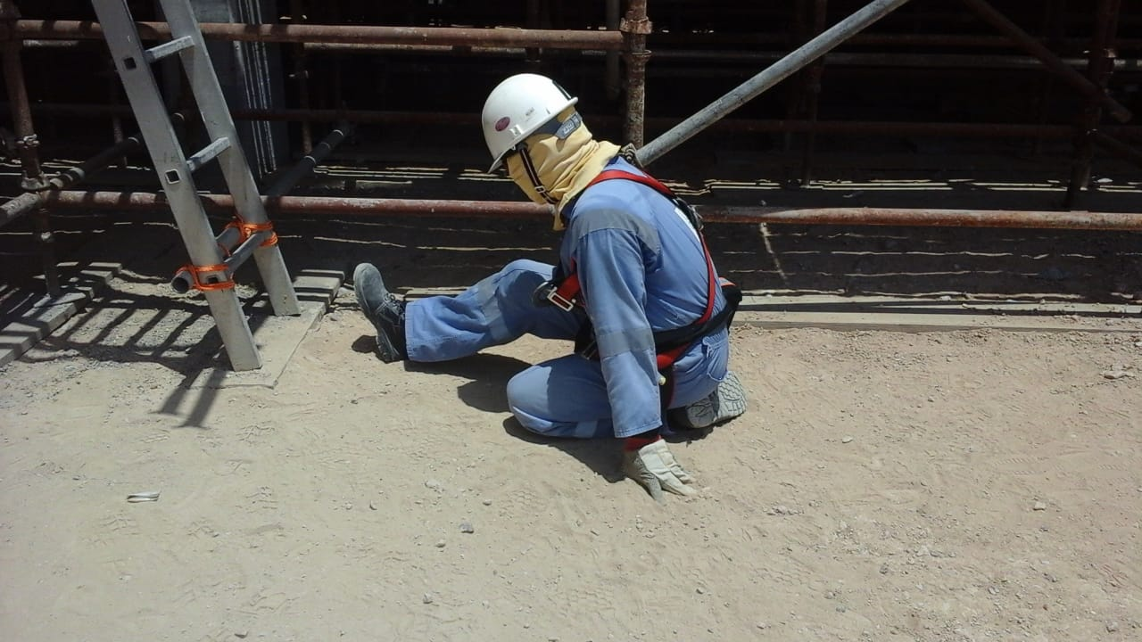
PDO Incident First Alert
Incident Type | LTI#18 | Pattern | Slip & Fall
Date / Time | 29.07.2020@10:30hrs | Directorate
Location | Qarn Alam | Dept
Target Audience
Construction, Operations, Logistics, Engineering , Exploration & Drilling
What happened
While the Carpenter was coming down from scaffolding, he lost his balance, slipped and fell fracturing his left leg.
Mr. Musleh asks the questions of can it happen to you?
How do you ensure where you are stepping is free from Hazards?
How do you ensure you have safe access and egress?
How do you identify Slip, Trips and fall hazards around your working location?
Do you ensure to use three points of contact while ascending/descending ladder?
Please disseminate this LTI notification to your teams and use it in your tool box talks and HSE meetings and notice boards.

