Slide 1
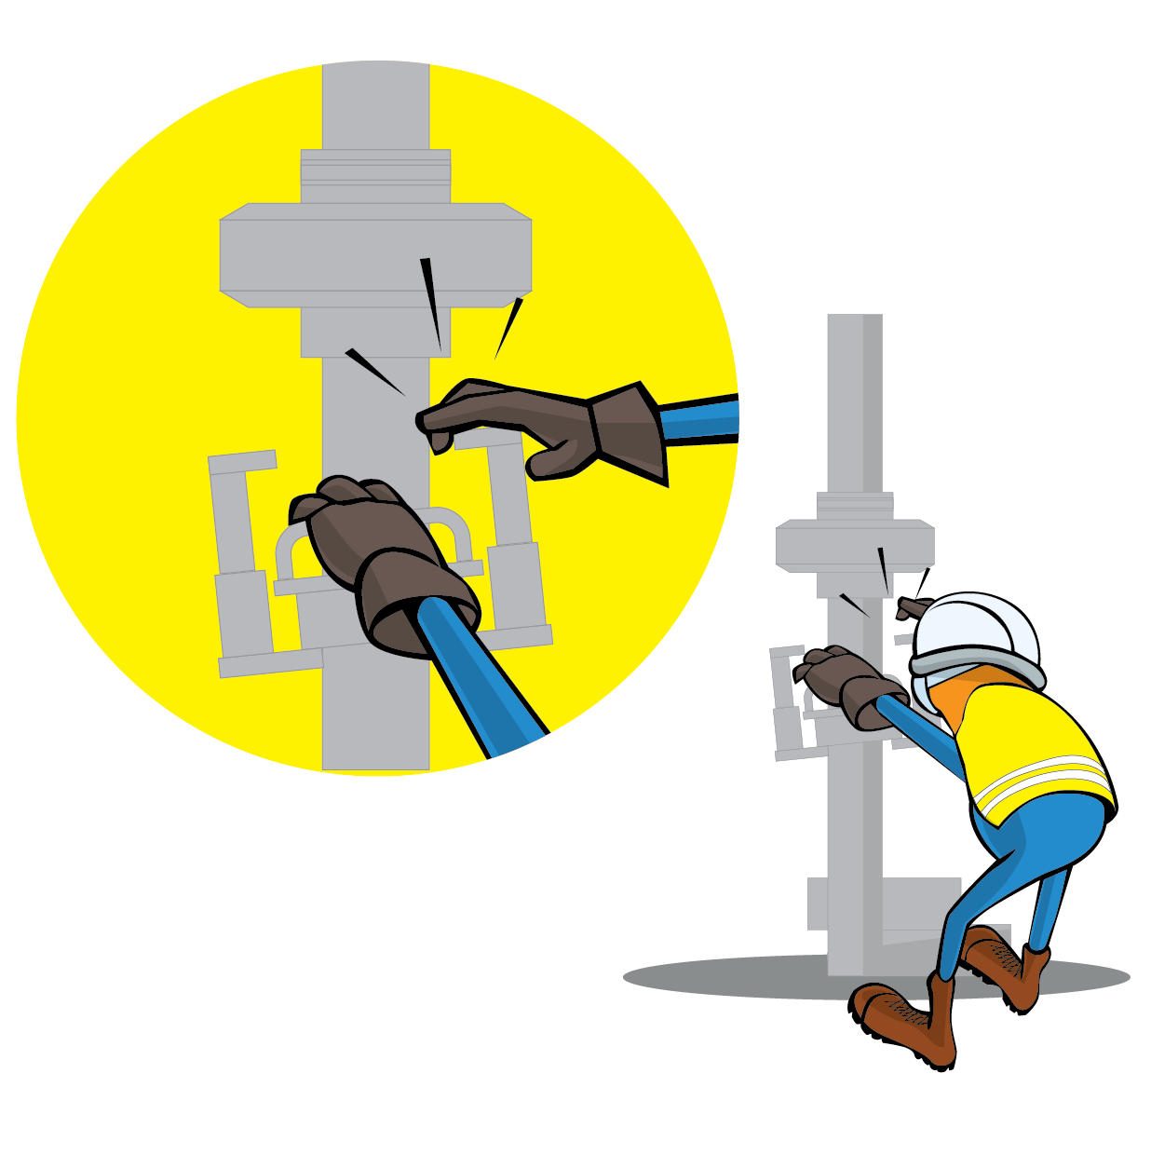
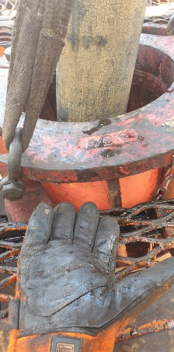
PDO Incident First Alert
Incident Type | LTI#24 | Pattern | Hands and Fingers
Date / Time | 20.09.2020@08:20hrs | Directorate
Location | Marmul | Dept
Target Audience
Construction, Drilling, Operations & Engineering
What happened
While the Engineer was attempting to balance the winch line, his left fourth finger got trapped between the safety floor and bowl housing of manual slips.
Mr. Musleh asks the questions of can it happen to you?
How do you ensure your Hands & Fingers are away from ‘Line of Fire’?
How do you ensure you identify all hazards before starting a task?
Do you consider “what could go wrong?”
Supervisor, do you ensure adequate supervision and avoid participate in the job?
Do you intervene whenever necessary?
Please disseminate this LTI notification to your teams and use it in your tool box talks and HSE meetings and notice boards.

