Slide 1
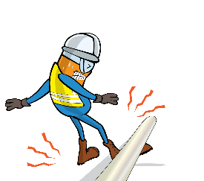
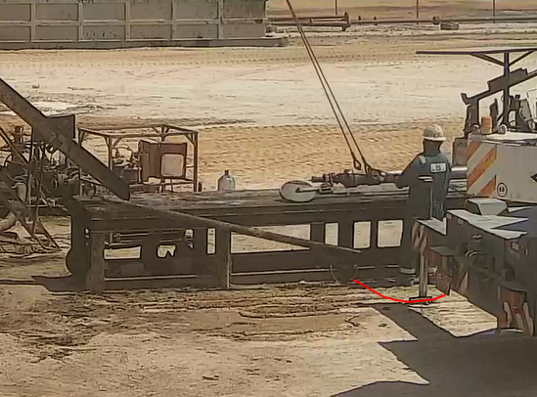
PDO Incident First Alert
Incident Type | LTI#25 | Pattern | Drops
Date / Time | 04.10.2020 at 12: 30:00hrs | Directorate
Location | Qarn Alam | Dept
Target Audience
Exploration & Drilling, Construction, Operations, Logistics, Engineering
What happened
The Slick Line Assistant was guiding the lubricator on the catwalk when the test joint rolled off the catwalk and fell striking his right foot causing fractured in his toe.
Mr. Musleh asks the questions of can it happen to you?
Do you ensure you identify all hazards before starting a task?
Do you consider if you are in the ‘line of fire’?
Do you use tagline to guide the load?
Do you intervene whenever required to stop unsafe Acts?
Please disseminate this LTI notification to your teams and use it in your tool box talks and HSE meetings and notice boards.

