Slide 1
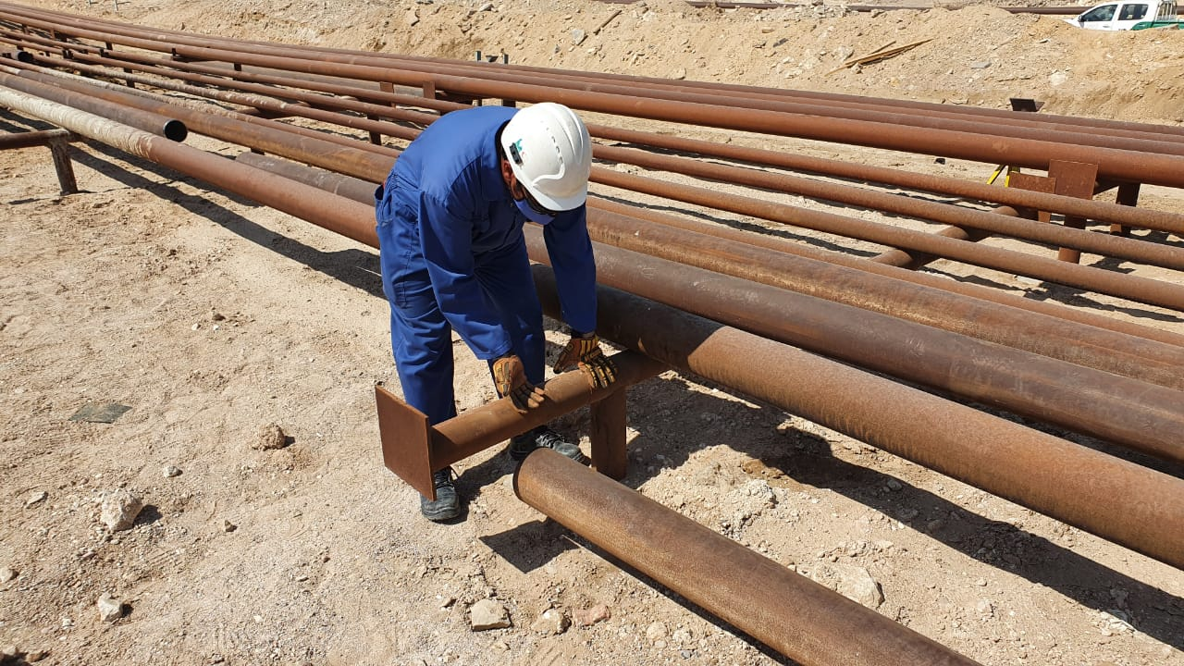
PDO Incident First Alert
Incident Type | LTI#26 | Pattern | Hands & fingers
Date / Time | 06.10.2020@9:00hrs | Directorate
Location | Fahud | Dept
Target Audience
Construction, Operations, Logistics, Engineering , Exploration & Drilling
What happened
While Mechanical Rigger was supporting the pipe end for welding, it slipped trapping the rigger’s right hand middle & ring finger between the pipe and the support.
Mr. Musleh asks the questions of can it happen to you?
How do you ensure you identify all hazards before starting a task?
Do you observes your colleague’s action during task and intervene if required?
Do you ensure adequate supervision during the task?
How do you ensure your Hands & Fingers are away from ‘Line of Fire’?
Pinch point
Please disseminate this LTI notification to your teams and use it in your tool box talks and HSE meetings and notice boards.

