Slide 1
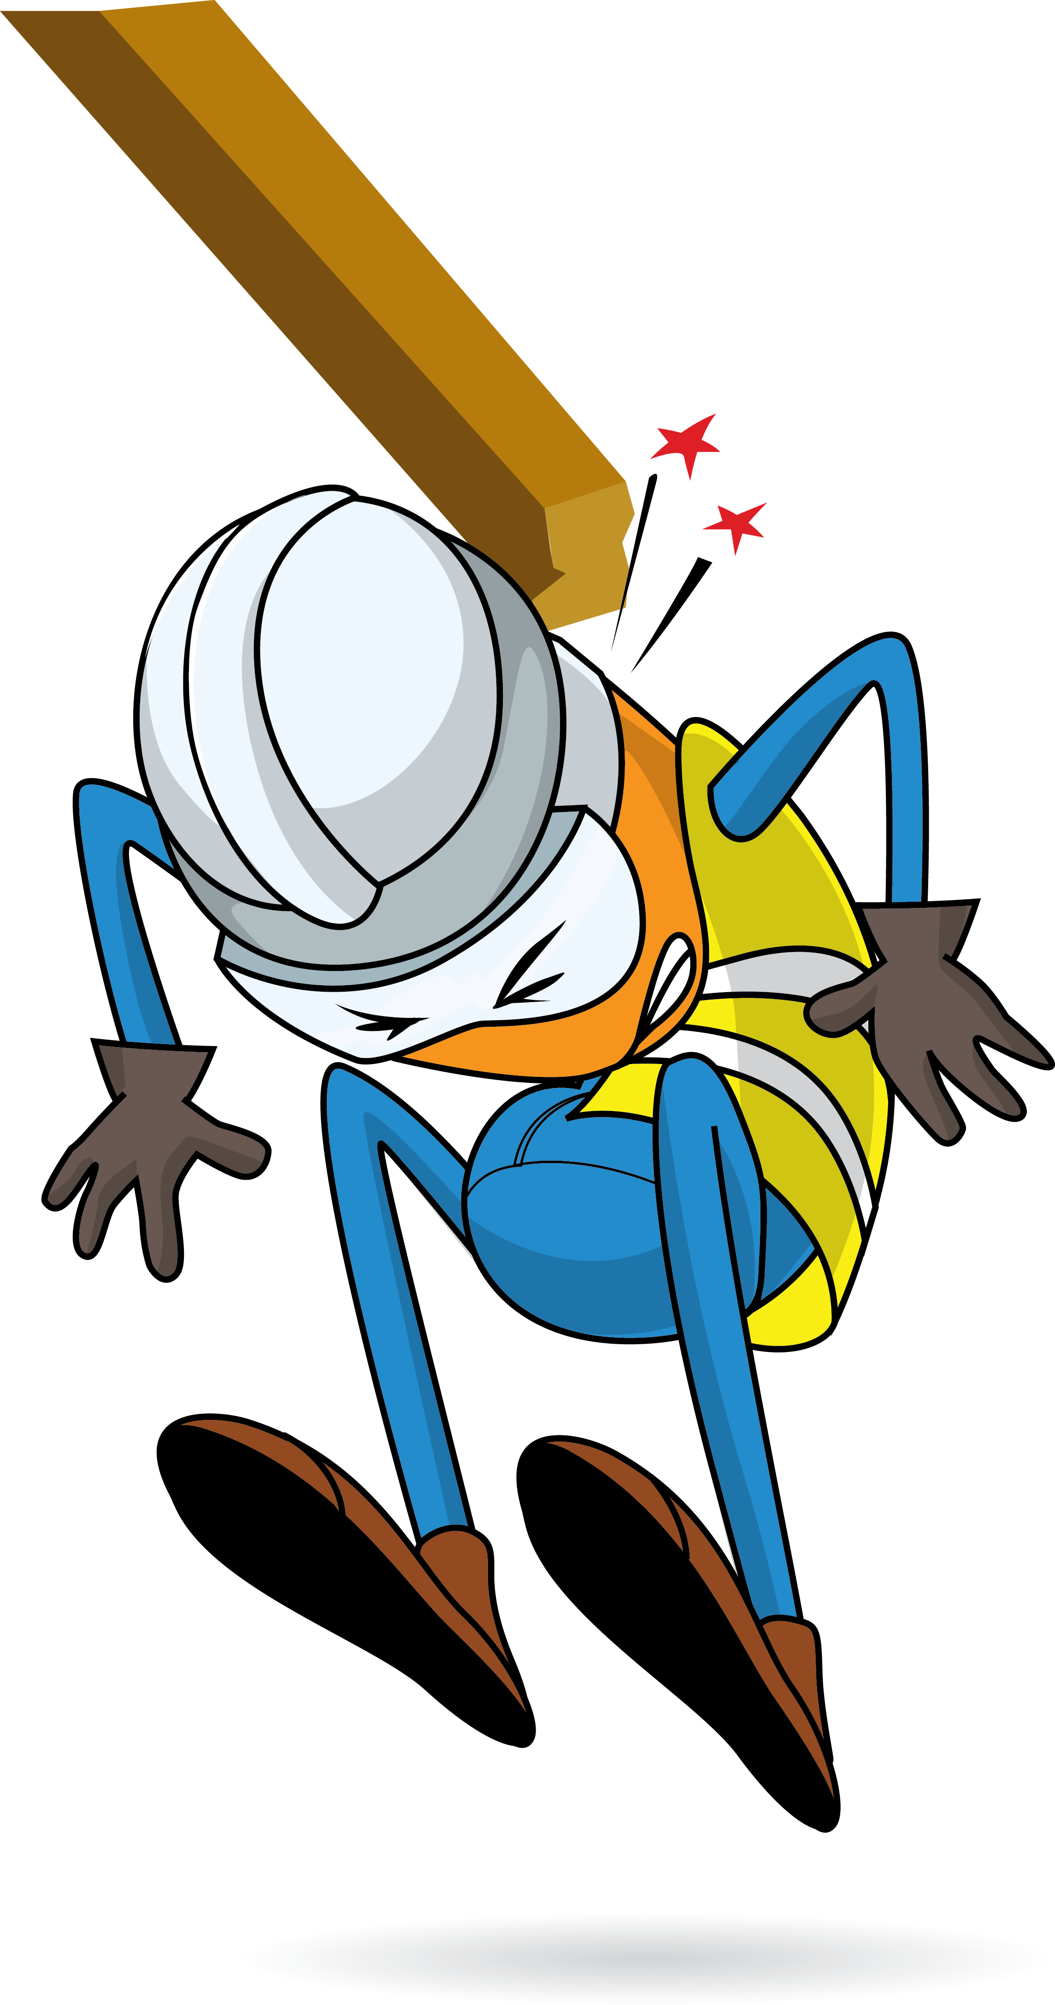
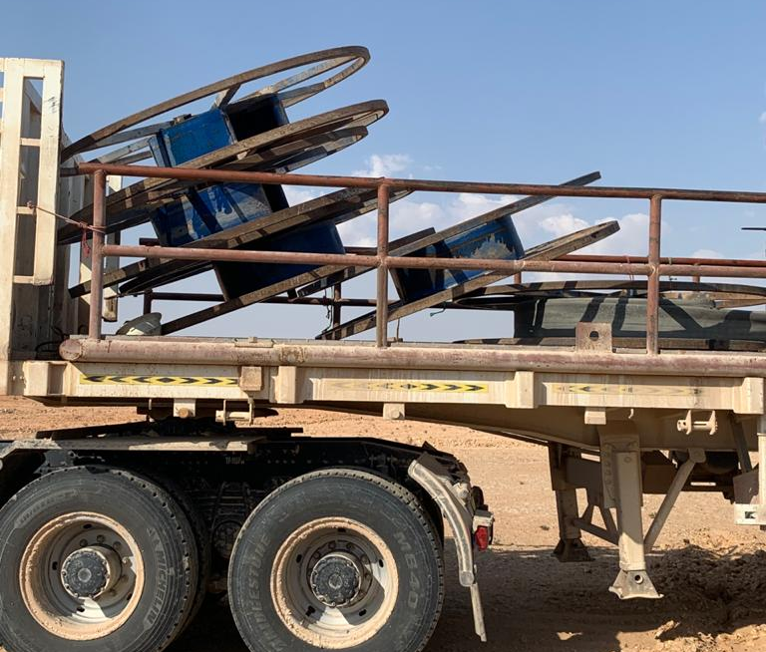


PDO Incident First Alert
Incident Type | LTI#27 | Pattern | DROPs
Date / Time | 14.10.2020@14:00hrs | Directorate
Location | Marmul | Dept
Target Audience
Construction, Operations, Logistics, Engineering , Exploration & Drilling
What happened
During laying down of water hose, while the Rigger and other crew member were standing on the trailer to align the hose, an empty hose reel fell on the Rigger causing an injury to his forehead and neck.
Mr. Musleh asks the questions of can it happen to you?
How do you ensure you identify all hazards before starting a task?
How do you ensure that you are away from ‘Line of Fire’?
Do you ensure you are following procedure and avoid taking shortcut?
Do you ensure adequate supervision during the task?
Please disseminate this LTI notification to your teams and use it in your tool box talks and HSE meetings and notice boards.

