Slide 1
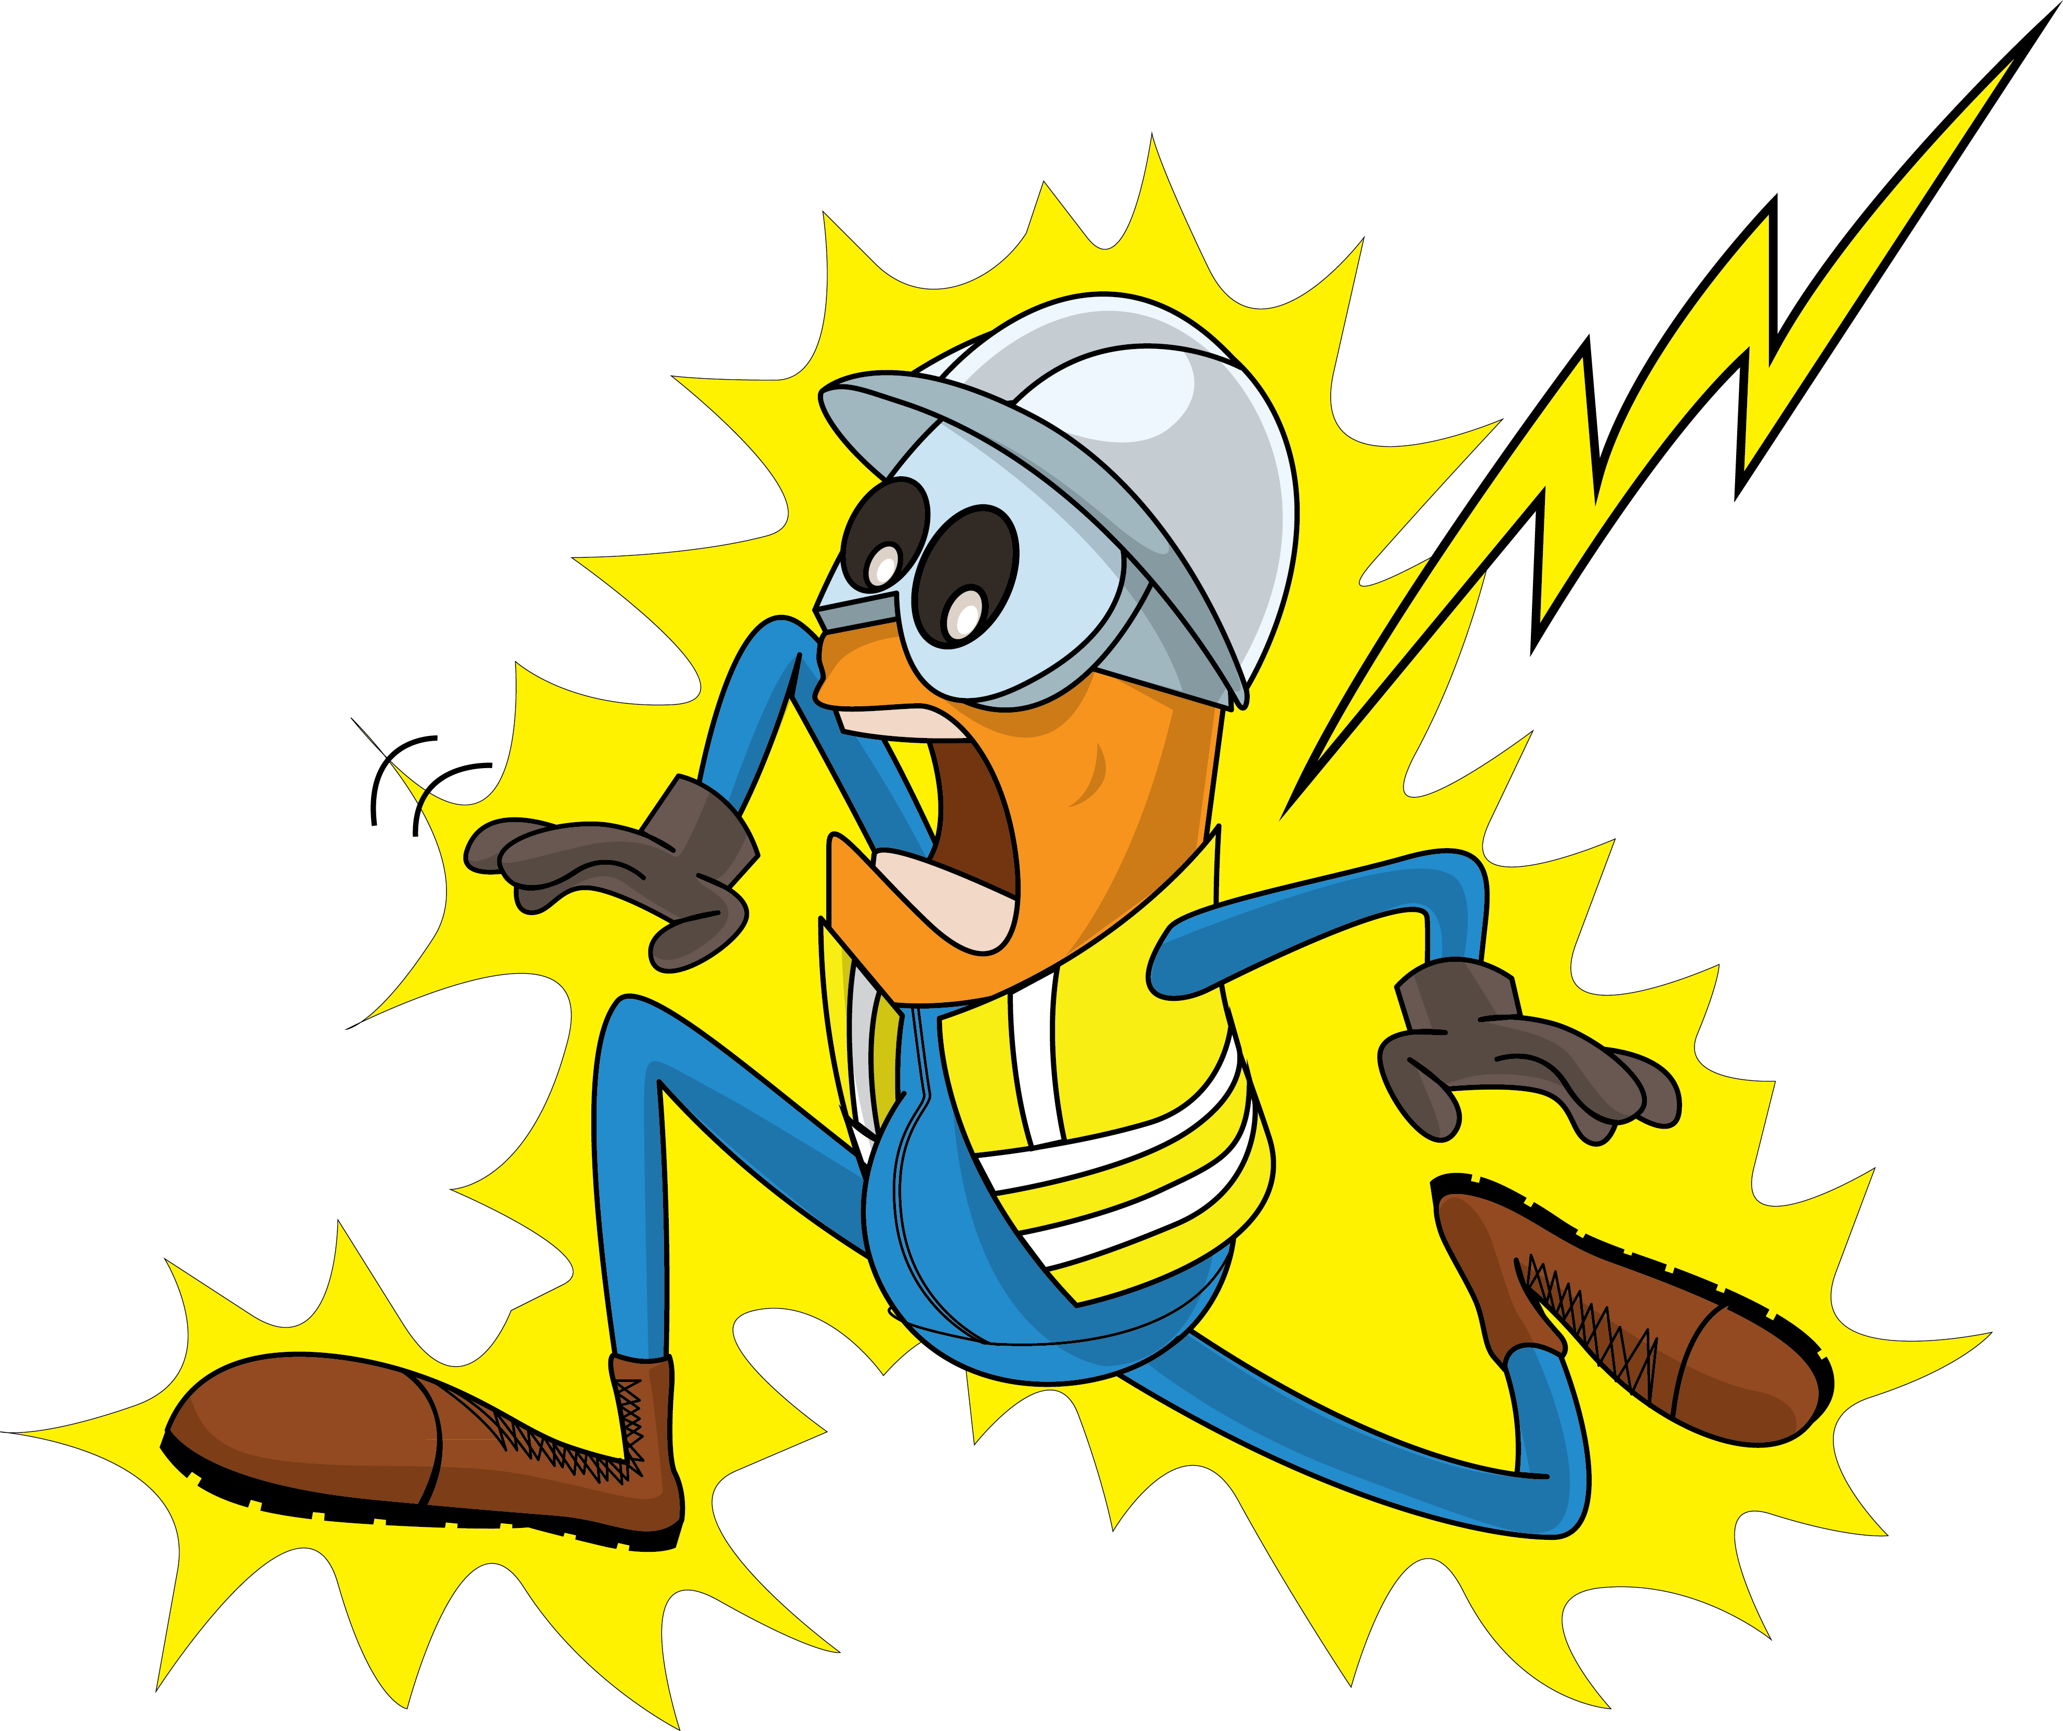
PDO Incident First Alert
Incident Type | LTI#28 | Pattern | Fire & Explosion
Date / Time | 15.10.2020@11:10hrs | Directorate
Location | Fahud | Dept
Target Audience
Construction, Operations, Logistics, Engineering , Exploration, Infrastructure & Drilling
What happened
While the technician was checking the power supply, the fuse fell onto the Busbar creating a short circuit with an electrical explosion resulting in burns to his left side.
Mr. Musleh asks the questions of can it happen to you?
Do you ensure the power is adequately isolated?
Do you ensure you have a valid Permit to Work (PTW) for the task?
How do you ensure you identify all hazards before starting a task?
How do you ensure that you are away from ‘Line of Fire’?
Please disseminate this LTI notification to your teams and use it in your tool box talks and HSE meetings and notice boards.

