Slide 1
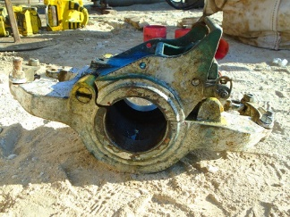
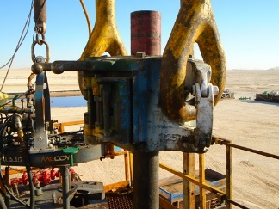
PDO Second Alert
Date: 19.01.2020 Incident title: HiPo#01
What happened?
At approximately 03:50 AM on 19th January 2020, Hoist was in process of pulling the work string after the cutting attempt. The landing joint coupling with Safety Valve snapped off and landed beside the draw-works, damaging the hydraulic valve mounting bolts of the mast raising cylinder. Zone management was followed, and nobody got injured.
Your learning from this incident..
Always ensure slip type elevator is used for Vam-top connections.
Always ensure the presence of third-party personnel whilst their equipment are in use.
Always ensure Third party personnel are attending TBT.
Ensure call out specifies the correct type of equipment as per OEM recommendations.
Ensure SOP is provided for all outsourced equipment.
Ensure zone management is always followed (positive finding in this case).
Ensure slip type elevator is used for Vam-top connections
Target Audience: Drilling, Logistics & Engineering
Notes:
Ensure all dates and titles are input
A short description should be provided without mentioning names of contractors or individuals. You should include, what happened, to who (by job title) and what injuries this resulted in. Nothing more!
Four to five bullet points highlighting the main findings from the investigation. Remember the target audience is the front line staff so this should be written in simple terms in a way that everyone can understand.
The strap line should be the main point you want to get across
The images should be self explanatory, what went wrong (if you create a reconstruction please ensure you do not put people at risk) and below how it should be done.

Slide 2
Management self audit
Date: 19.01.2020 Incident title: HiPo#01
As a learning from this incident and ensure continual improvement all contract
managers must review their HSE HEMP against the questions asked below
Confirm the following:
Do you ensure the third-party equipment comes with proper user instructions?
Do you ensure the third party is present in TBT and HEMP is discussed?
Do you ensure the Site leaders understand the operating instructions of the third-party equipment?
Do you ensure Zone management is adequately implemented?
Do you ensure the rig crew use the third-party equipment only with their presence?
* If the answer is NO to any of the above questions please ensure you take action to correct this finding.
Notes:
Ensure all dates and titles are input
Make a list of closed questions (only ‘yes’ or ‘no’ as an answer) to ask others if they have the same issues based on the management or HSE-MS failings or shortfalls identified in the investigation.
Imagine you have to audit other companies to see if they could have the same issues.
These questions should start with: Do you ensure…………………?

