Slide 1
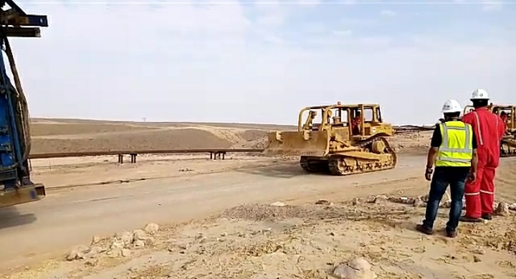
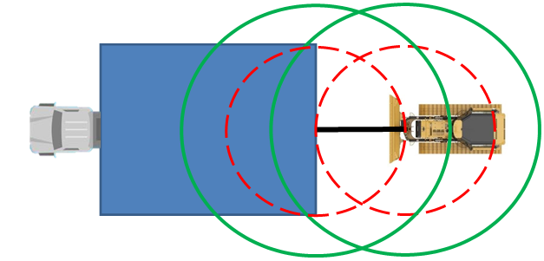
PDO Second Alert
Date: 24.01.2020 Incident title: HiPo#02
What happened?
A Rig mast carrier was being transported down an incline, on route to the new location. The Rig mast carrier was supported by the use of four D8 Dozers positioned in series at the rear. Once the rig carrier passed the apex of the descent, the 28mm steel wire rope connecting the first D8 to the carrier parted. The rig continued its descent under the control of the prime mover and rig mast brakes and stopped safely at the bottom of the decline.
Your learning from this incident..
Ensure you are stood in the safe working zone.
Ensure you have the correct tools to conduct your task safely.
Ensure you conduct pre use checks of all equipment and accessories.
Ensure you raise any doubt or concerns to management.
Ensure you and others stand at a safe distance from tensioned lines.
a safety factor of ½ the length of the steel wire rope must be added to maintain a safe distance
Maintain 1.5 x distance, 360 degree around each end of steel wire ropes, when in use
Target Audience: Drilling & Logistics
Notes:
Ensure all dates and titles are input
A short description should be provided without mentioning names of contractors or individuals. You should include, what happened, to who (by job title) and what injuries this resulted in. Nothing more!
Four to five bullet points highlighting the main findings from the investigation. Remember the target audience is the front line staff so this should be written in simple terms in a way that everyone can understand.
The strap line should be the main point you want to get across
The images should be self explanatory, what went wrong (if you create a reconstruction please ensure you do not put people at risk) and below how it should be done.

Slide 2
Management self audit
Date: 24.01.2020 Incident title: HiPo#02
As a learning from this incident and to ensure continual improvement, all contract managers must review their HSE HEMP against the questions asked below
Confirm the following:
Do you ensure management of change is effectively implemented and followed through?
Does your route surveys capture all risks on route and are control measures in place to manage these hazards?
Do you ensure all tasks are thoroughly assessed?
Does your Risk Assessment contain a requirement to carry out a formal assessment to ascertain slope, force and rigging assembly capacity with documented formal calculations, prior to your equipment ascending or descending an incline?
Do you ensure Risk Assessments are reviewed against actual tasks?
Do you ensure your staff are trained and competency assessed?
* If the answer is NO to any of the above questions please ensure you take action to correct this finding.
Notes:
Ensure all dates and titles are input
Make a list of closed questions (only ‘yes’ or ‘no’ as an answer) to ask others if they have the same issues based on the management or HSE-MS failings or shortfalls identified in the investigation.
Imagine you have to audit other companies to see if they could have the same issues.
These questions should start with: Do you ensure…………………?

