Slide 1
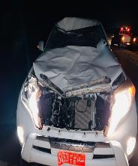
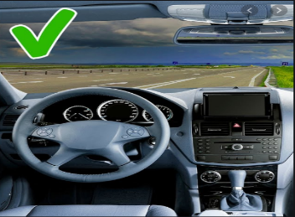
PDO Second Alert
Date: 02.02.2020 Title: HiPo#04
What happened?
On 02.02.2020 at approximately 19.30hrs. A driver while driving at night collided with 2 camels that were walking in the middle black top road. After the collision the vehicle moved to the hard shoulder and came to a halt. There were no injuries to the driver but vehicle sustain extensive damage. The camels left the scene, no evidence that the camel was injured.
Your learning from this incident..
Night driving can only be completed after authorization, of MSE7 or Local Co- Ordinator (Emergencies Only) regardless of distance.
Plan work accordingly so there is no need for night driving.
Journey management must be adhered to as per SP- 2000v4.
Always adjust your driving to road and environmental conditions.
Understand the hazards of the road and journey before you start .
Be bright & don’t drive at night
Target Audience: Drilling, Logistics, Operation, Engineering, Construction & Exploration
Notes:
Ensure all dates and titles are input
A short description should be provided without mentioning names of contractors or individuals. You should include, what happened, to who (by job title) and what injuries this resulted in. Nothing more!
Four to five bullet points highlighting the main findings from the investigation. Remember the target audience is the front line staff so this should be written in simple terms in a way that everyone can understand.
The strap line should be the main point you want to get across
The images should be self explanatory, what went wrong (if you create a reconstruction please ensure you do not put people at risk) and below how it should be done.

Slide 2
Management self audit
Date: 02.02.2020 Title: HiPo#04
As a learning from this incident and ensure continual improvement all contract
managers must review their HSE HEMP against the questions asked below
Confirm the following:
Do you ensure driver is aware of all driving hazards in the area?
Do you ensure you conduct regular briefings prior to all journeys?
Do you ensure routine driving tasks are planned in accordance with SP 2000 ?
Do you ensure that you plan all work activities during day light hours?
Do you ensure that approval for all journeys are authorized by a journey manager and as necessary by the PDO Area Co-ordinator?
Do you ensure that HSE Management of Change is carried out when there has been a change in the scope of work?
**If the answer is NO to any of the above questions please ensure you take action to correct this finding.
Notes:
Ensure all dates and titles are input
Make a list of closed questions (only ‘yes’ or ‘no’ as an answer) to ask others if they have the same issues based on the management or HSE-MS failings or shortfalls identified in the investigation.
Imagine you have to audit other companies to see if they could have the same issues.
These questions should start with: Do you ensure…………………?

