Slide 1
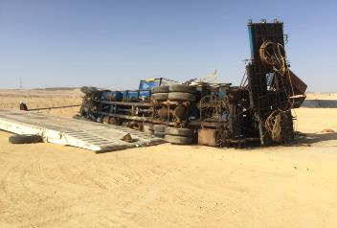
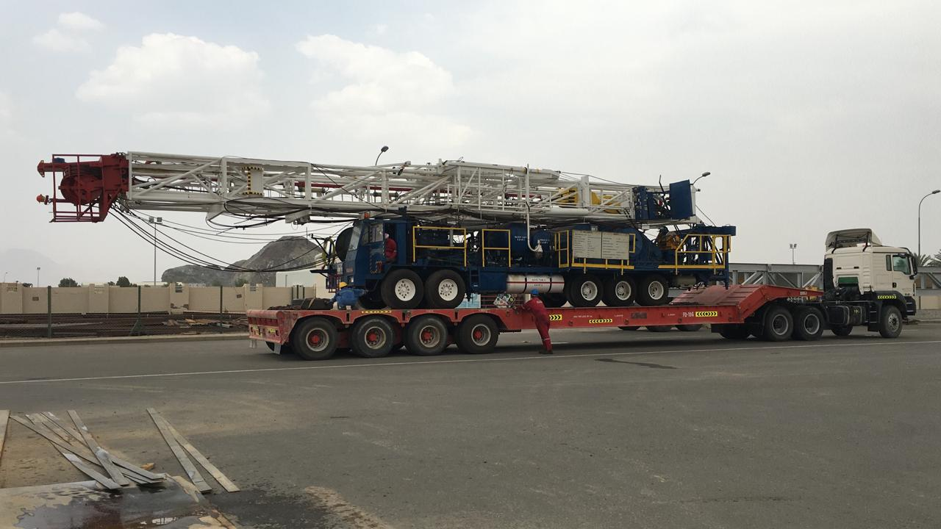
PDO Second Alert
Date: 06.02.2020 Incident title: HiPo#05
What happened?
At around 09:00 am, Carrier was spotted on the Low-Bed truck, it was noticed that the hoist carrier is not in the center of the low bed (Right side tires were slightly on the edge of the low bed). The driver informed RM and they decided to move and bring it to the center. It started with the HGV driver going forward while adjusting the direction of the carrier, as he was going on reverse the carrier tire on the right side crossed the edge resulting in falling the whole carrier on its right side. No injuries were reported.
Your learning from this incident..
Always ensure effective Banks man available at all sides to giving signals to the driver.
Rig manager to ensure the Carrier loading operation is done under his full supervision from its very start.
All banks men shall be on a safe distance around the low bed while loading is ongoing
Always ensure empowerment to stop work is been exercised.
Always Ensure PTW in place is effective
Always Align the Vehicle prior loading onto low bed
Target Audience: Drilling, Logistics, Engineering & construction
Notes:
Ensure all dates and titles are input
A short description should be provided without mentioning names of contractors or individuals. You should include, what happened, to who (by job title) and what injuries this resulted in. Nothing more!
Four to five bullet points highlighting the main findings from the investigation. Remember the target audience is the front line staff so this should be written in simple terms in a way that everyone can understand.
The strap line should be the main point you want to get across
The images should be self explanatory, what went wrong (if you create a reconstruction please ensure you do not put people at risk) and below how it should be done.

Slide 2
Management self audit
Date: 06.02.2020 Incident title: HiPo#05
As a learning from this incident and ensure continual improvement all contract
managers must review their HSE HEMP against the questions asked below
Confirm the following:
Do you ensure Loading/unloading operation on low bed are included in your procedure and dynamic risk assessed?
Do you ensure Loading/unloading operation appropriately supervised ?
Do you ensure appropriate interventions/STOP are exercised within your team?
Do you ensure competent banksman are available and trained ?
Do you ensure PTW procedure is effective ?
* If the answer is NO to any of the above questions please ensure you take action to correct this finding.
Notes:
Ensure all dates and titles are input
Make a list of closed questions (only ‘yes’ or ‘no’ as an answer) to ask others if they have the same issues based on the management or HSE-MS failings or shortfalls identified in the investigation.
Imagine you have to audit other companies to see if they could have the same issues.
These questions should start with: Do you ensure…………………?

