Slide 1
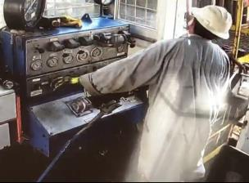
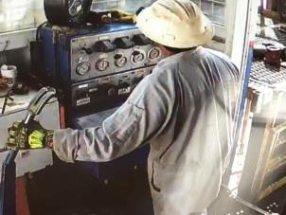
PDO Second Alert
Date:10.02.2020 Incident title: HiPo#06
What happened?
At approximately 10:24hrs on 10thFebruary 2020, running in hole milling bottom hole assembly was in progress. Assistant driller was on the brake and a floor man was operating the power tong to disengage. During this time the Assistant driller released his hand from the brake handle and stretched himself out of the driller’s cabin for better view. As a result the work string moved up and the power tong was pulled along with it. This resulted the support arms of the power tong to break and power tong slid back to the tool joint.
Your learning from this incident..
Always ensure the Assistant driller is supervised whilst he is on the brake.
Always adhere to standard operating procedures.
Always chain the brake handle before hands off.
Never leave the brake handle without securing.
Target Audience: Drilling
Notes:
Ensure all dates and titles are input
A short description should be provided without mentioning names of contractors or individuals. You should include, what happened, to who (by job title) and what injuries this resulted in. Nothing more!
Four to five bullet points highlighting the main findings from the investigation. Remember the target audience is the front line staff so this should be written in simple terms in a way that everyone can understand.
The strap line should be the main point you want to get across
The images should be self explanatory, what went wrong (if you create a reconstruction please ensure you do not put people at risk) and below how it should be done.

Slide 2
Management self audit
Date:10.02.2020 Incident title: HiPo#06
As a learning from this incident and ensure continual improvement all contract
managers must review their HSE HEMP against the questions asked below
Confirm the following:
Do you ensure the Rig manager / Night tool pusher must be on the Rig floor when Driller is away?
Do you ensure the modifications are risk assessed prior to install?
Do you ensure Driller has clear visibility over the activities on the Rig floor?
Do you ensure all modification on the Rig floor is with OEM approval?
* If the answer is NO to any of the above questions please ensure you take action to correct this finding.
Notes:
Ensure all dates and titles are input
Make a list of closed questions (only ‘yes’ or ‘no’ as an answer) to ask others if they have the same issues based on the management or HSE-MS failings or shortfalls identified in the investigation.
Imagine you have to audit other companies to see if they could have the same issues.
These questions should start with: Do you ensure…………………?

