Slide 1
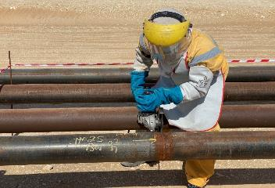
PDO Second Alert
Date: 21.02.2020 Incident title: HiPo#07
What happened?
A foreman and his crew were tasked to carryout a weld repair on a new pipe line (not live). The foreman and crew went to the wrong location and started repair work without a permit to work by grinding the weld joint of a live line. On realizing it was the wrong line the crew were instructed to weld the cut area. While the welding was ongoing, the riggers came and informed the foreman that this line is live. All activities were stopped and the crew demobilized from the location.
Your learning from this incident..
Always discuss and understand the activity with the permit holder prior to commencing the job.
Always ensure you are at correct location prior to starting work.
Always intervene and stop the work if you feel it is unsafe.
Always discuss and understand the activity with the permit holder prior to commencing the job
Target Audience: Operation, Engineering & Construction
Notes:
Ensure all dates and titles are input
A short description should be provided without mentioning names of contractors or individuals. You should include, what happened, to who (by job title) and what injuries this resulted in. Nothing more!
Four to five bullet points highlighting the main findings from the investigation. Remember the target audience is the front line staff so this should be written in simple terms in a way that everyone can understand.
The strap line should be the main point you want to get across
The images should be self explanatory, what went wrong (if you create a reconstruction please ensure you do not put people at risk) and below how it should be done.

Slide 2
Management self audit
Date: 21.02.2020 Incident title: HiPo#07
As a learning from this incident and ensure continual improvement all contract
managers must review their HSE HEMP against the questions asked below
Confirm the following:
Do you ensure that each activity requiring Permit is discussed with the team at the location prior to starting the work?
Do you ensure that TBT is carried out prior to each activity?
Do you ensure Empowerment to STOP is effectively communicated and implemented among the employees?
Do you ensure that all possible risks associated to potential shortcuts are addressed in the HEMP?
Do you ensure that the supervisors are following the PTW (PA / Site Manager Site visits etc)?
* If the answer is NO to any of the above questions please ensure you take action to correct this finding.
Notes:
Ensure all dates and titles are input
Make a list of closed questions (only ‘yes’ or ‘no’ as an answer) to ask others if they have the same issues based on the management or HSE-MS failings or shortfalls identified in the investigation.
Imagine you have to audit other companies to see if they could have the same issues.
These questions should start with: Do you ensure…………………?

