Slide 1
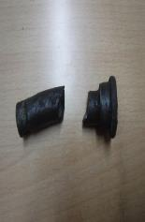
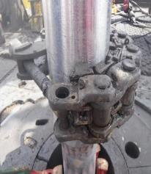
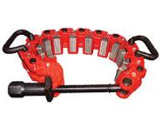
PDO Second Alert
Date: 20.02.2020 Incident title: HiPo#09
What happened?
During RIH BHA operation, floor man was preparing to make connection, slips were set, safety clamp installed and tightened. All 3 floor men were supporting to remove lifting sub with chain tong when suddenly a pin from safety clamp ejected, striking one of the floor-man helmet as a result helmet dropped down. Floor-man had mild swelling on left temporal area.
Your learning from this incident..
Ensure the correct size and number of segments is used for each tubular size as per OEM recommendations.
As per OEM recommendation, end user to determine clamping torque. (Clamping torque necessary to prevent markings / damaging tubulars).
Ensure safety clamp is visually inspected prior use.
Ensure safety clamp has correct number of segment & do not apply excessive torque
Target Audience: Drilling, Logistics & construction
Notes:
Ensure all dates and titles are input
A short description should be provided without mentioning names of contractors or individuals. You should include, what happened, to who (by job title) and what injuries this resulted in. Nothing more!
Four to five bullet points highlighting the main findings from the investigation. Remember the target audience is the front line staff so this should be written in simple terms in a way that everyone can understand.
The strap line should be the main point you want to get across
The images should be self explanatory, what went wrong (if you create a reconstruction please ensure you do not put people at risk) and below how it should be done.

Slide 2
Management self audit
Date: 20.02.2020 Incident title: HiPo#09
As a learning from this incident and ensure continual improvement all contract
managers must review their HSE HEMP against the questions asked below
Confirm the following:
Do you ensure the number of segments are correct for the particular activity for safety clamp?
Do you ensure the specific torque requirements for each type of tubular?
Do you ensure that crew members understand line of fire?
Do you ensure all handling equipment included in maintenance work orders?
Do you ensure your supervisors aware of critical activities, they must supervise?
Do you ensure that you regularly update your SOP?
* If the answer is NO to any of the above questions please ensure you take action to correct this finding.
Notes:
Ensure all dates and titles are input
Make a list of closed questions (only ‘yes’ or ‘no’ as an answer) to ask others if they have the same issues based on the management or HSE-MS failings or shortfalls identified in the investigation.
Imagine you have to audit other companies to see if they could have the same issues.
These questions should start with: Do you ensure…………………?

