Slide 1
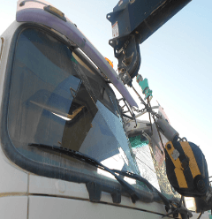
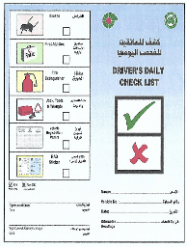
PDO Second Alert
Date: 25.02.2020 Incident title: HiPo#10
What happened?
On 25.02.2020 at around 07:35 hrs., Brackish water tanker was taken by driver to wash bay for cleaning. When he noticed that there was a WL Unit 06 already parked in the wash bay for cleaning, he decided to wash front portion of tanker without disturbing other vehicle driver, and moved close to the WL unit and applied brake to stop the tanker, but unfortunately the tanker’s brake failed and it hit the WL unit boom hook resulting in damage to wind screen & bumper of the tanker . No injures to personnel.
Your learning from this incident..
Daily morning vehicle inspections to be done as per SP-2000.
Ensure Preventive Maintenance System in place and working effectively.
Always apply defensive driving techniques.
Ensure wash bay activities are properly planned and incorporated in your procedures.
Ensure supervision available to monitor washing bay activities.
Ensure banksman provided to guide vehicle/equipment.
Comprehensive Vehicle Daily Checks have to be performed prior to moving the vehicle
Target Audience: Drilling, Logistics, Operation, Engineering, Exploration & construction
Notes:
Ensure all dates and titles are input
A short description should be provided without mentioning names of contractors or individuals. You should include, what happened, to who (by job title) and what injuries this resulted in. Nothing more!
Four to five bullet points highlighting the main findings from the investigation. Remember the target audience is the front line staff so this should be written in simple terms in a way that everyone can understand.
The strap line should be the main point you want to get across
The images should be self explanatory, what went wrong (if you create a reconstruction please ensure you do not put people at risk) and below how it should be done.

Slide 2
Management self audit
Date: 25.02.2020 Incident title: HiPo#10
As a learning from this incident and ensure continual improvement all contract
managers must review their HSE HEMP against the questions asked below
Confirm the following:
Do you ensure supervisors conduct spot checks on drivers and vehicles?
Do you ensure adequate Preventive Maintenance procedure in place and working effective?
Do you ensure verification process that procedures are being followed in the field?
Do you ensure that staff are competent for the job?
Do you conduct drivers engagement sessions regularly ?
Do you ensure that your HEMP is regularly reviewed?
* If the answer is NO to any of the above questions please ensure you take action to correct this finding.
Notes:
Ensure all dates and titles are input
Make a list of closed questions (only ‘yes’ or ‘no’ as an answer) to ask others if they have the same issues based on the management or HSE-MS failings or shortfalls identified in the investigation.
Imagine you have to audit other companies to see if they could have the same issues.
These questions should start with: Do you ensure…………………?

