Slide 1
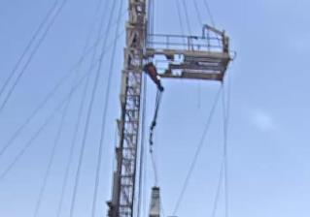
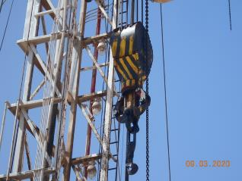
PDO Second Alert
Date: 28.02.2020 Incident title: HiPo#11
What happened?
During RIH 1” SR from ground, the Driller was on the break. A floor man, RM & 2 OHI engineers were on the rig floor. While raising the traveling block , the edge of the Traveling block hit the monkey board side walk way edge causing the traveling block to swing and the attached Sucker rod struck the helmet of the FM.
Your learning from this incident..
Always Ensure to check the wind speed in windy condition prior to start operation. Stop work during high winds.
Always ensure to perform dynamic risk review during the operation.
Always make sure Elevator bails to be avoided for sucker rod operation.
Always Make sure to intervene if there seems to be an unsafe condition.
Always ensure to perform proper Risk assessment prior to start job.
Travelling block hitting against the monkey board side walkway
Sucker rod hook directly attached with Traveling block
Ensure to use correct equipment for the task.
Target Audience: Drilling, Logistics, Exploration & construction
Notes:
Ensure all dates and titles are input
A short description should be provided without mentioning names of contractors or individuals. You should include, what happened, to who (by job title) and what injuries this resulted in. Nothing more!
Four to five bullet points highlighting the main findings from the investigation. Remember the target audience is the front line staff so this should be written in simple terms in a way that everyone can understand.
The strap line should be the main point you want to get across
The images should be self explanatory, what went wrong (if you create a reconstruction please ensure you do not put people at risk) and below how it should be done.

Slide 2
Management self audit
Date: 28.02.2020 Incident title: HiPo#11
As a learning from this incident and ensure continual improvement all contract
managers must review their HSE HEMP against the questions asked below
Confirm the following:
Do you ensure inspection/checks on wind speed to check if it is favorable for operation?
Do you ensure that all hazards are made aware of by dynamic risk assessment?
Do you ensure that SOP is reviewed regularly and fit for work?
Do you ensure that SOP is communicated after review to all employees?
Do you ensure that CCTV review has been done regularly to identify critical unsafe behaviors?
Do you ensure that audit / inspection has been performed for all critical activities to find the shortfalls?
Do you ensure that Competence assessment conducted for driller and Rig Managers and all gap closed?
If the answer is NO to any of the above questions please ensure you take action to correct this finding.
Notes:
Ensure all dates and titles are input
Make a list of closed questions (only ‘yes’ or ‘no’ as an answer) to ask others if they have the same issues based on the management or HSE-MS failings or shortfalls identified in the investigation.
Imagine you have to audit other companies to see if they could have the same issues.
These questions should start with: Do you ensure…………………?

