Slide 1
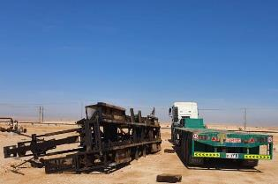
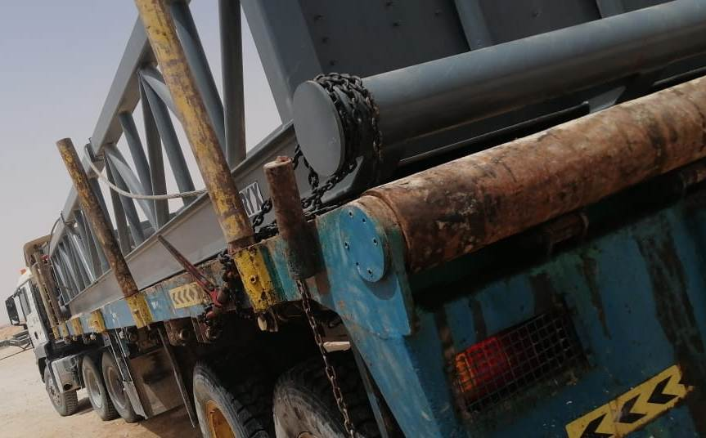
PDO Second Alert
Date: 20.02.2020 Incident title: HiPo#12
What happened?
At around 07:50 am while transporting the catwalk from the location QRMS-8 to QRMS-9 as a part of rig move , the catwalk skid got slipped from the trailer bed and dropped on to the ground.
Your learning from this incident..
Always ensure to plan the job adequately.
Always ensure the catwalk skid is correctly secured on the trailer bed and from both ends using chain prior to start journey.
Always ensure to fill checklist for checking loaded trailers before journey.
Always ensure that the driver check and secure load prior to move.
Always ensure to have required sets of lashing chains.
Always ensure to have supervision at old location to assure the secured load.
Always ensure the adequate load restraint to prevent unstoppable movement.
Catwalk secured to the trailer from both ends
Always ensure to secure the load secure prior to start journey.
Target Audience: Drilling, Logistics, Exploration
Notes:
Ensure all dates and titles are input
A short description should be provided without mentioning names of contractors or individuals. You should include, what happened, to who (by job title) and what injuries this resulted in. Nothing more!
Four to five bullet points highlighting the main findings from the investigation. Remember the target audience is the front line staff so this should be written in simple terms in a way that everyone can understand.
The strap line should be the main point you want to get across
The images should be self explanatory, what went wrong (if you create a reconstruction please ensure you do not put people at risk) and below how it should be done.

Slide 2
Management self audit
Date: 20.02.2020 Incident title: HiPo#12
As a learning from this incident and ensure continual improvement all contract
managers must review their HSE HEMP against the questions asked below
Confirm the following:
Do you ensure all hazards and risk mitigation for activities covered during your TBT?
Do you ensure that the job is planned adequately?
Do you ensure that effective Learning from incident system in place?
Do you ensure that the loads are secured properly prior to move as per SP 2001?
Do you ensure there are enough number of lashing chains for securing loads?
Do you ensure the trailer checklist is completed before moving?
Do you ensure that the adequate supervision is available during rig move?
DO you ensure that the verification is performed for yearly assurance plan?
If the answer is NO to any of the above questions please ensure you take action to correct this finding.
Notes:
Ensure all dates and titles are input
Make a list of closed questions (only ‘yes’ or ‘no’ as an answer) to ask others if they have the same issues based on the management or HSE-MS failings or shortfalls identified in the investigation.
Imagine you have to audit other companies to see if they could have the same issues.
These questions should start with: Do you ensure…………………?

