Slide 1
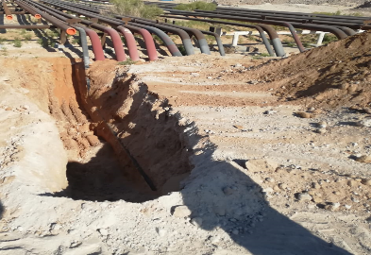
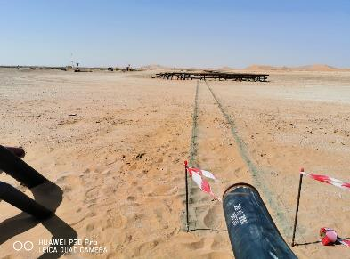
PDO Second Alert
Date: 04.03.2020 Incident Title: HiPo#13
What happened?
Mechanical excavation using a JCB backhoe for road crossing executed very close to the live flowline without keeping a safe distance of 1 meter from the live flowline.
Your learning from this incident..
Always ensure that you maintain the 1 meter safe distance from live line for mechanical excavation or 0.5 meter to be maintained after ensuing the live line is isolated.
Always ensure that you identify the Buried line and mark the entire session.
Always make sure that you do the trial pit before mechanical excavation.
Always ensure compliance to PTW system as per PR-1172 requirement.
Marking for excavation
Always comply with the Procedures. NO Shortcuts.
Line to be installed
Target Audience: Operation, Engineering & Construction
Notes:
Ensure all dates and titles are input
A short description should be provided without mentioning names of contractors or individuals. You should include, what happened, to who (by job title) and what injuries this resulted in. Nothing more!
Four to five bullet points highlighting the main findings from the investigation. Remember the target audience is the front line staff so this should be written in simple terms in a way that everyone can understand.
The strap line should be the main point you want to get across
The images should be self explanatory, what went wrong (if you create a reconstruction please ensure you do not put people at risk) and below how it should be done.

Slide 2
Management self audit
Date: 04.03.2020 Incident Title: HiPo#13
As a learning from this incident and ensure continual improvement all contract
managers must review their HSE HEMP against the questions asked below
Confirm the following:
Do you ensure job is executed as per PTW requirements?
Do you ensure PTW system audit is performed effectively covering all requirements?
Do you ensure that your team always intervene to unsafe act/condition?
Do you ensure competent supervision is provided?
Do you ensure employees do not take short cuts?
Do you ensure adequate subcontractor monitoring is maintained?
* If the answer is NO to any of the above questions please ensure you take action to correct this finding.
Notes:
Ensure all dates and titles are input
Make a list of closed questions (only ‘yes’ or ‘no’ as an answer) to ask others if they have the same issues based on the management or HSE-MS failings or shortfalls identified in the investigation.
Imagine you have to audit other companies to see if they could have the same issues.
These questions should start with: Do you ensure…………………?

