Slide 1
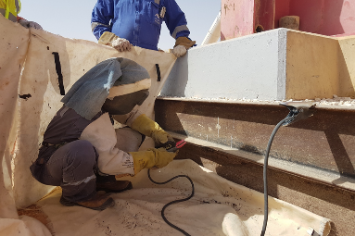
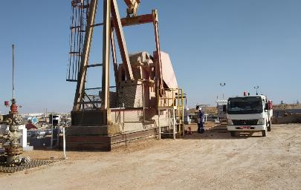
PDO Second Alert
Date: 05.03.2020 Incident title: HiPo#14
What happened?
During a routine site visit by a Operator on 05th March 2020 at 17:00 hrs., observed that a mechanical crew were welding on the beam pump base (Gravel Pan) whilst the pump was in operation. The operator intervened and stopped the activity after inspecting the permit which had no well number mentioned, stopped the activity and returned to suspend the permit. The operator reported the incident as a near miss.
Your learning from this incident..
Always ensure the activity is planned w.r.t people , procedure and permits.
Always ensure specific permit for carrying out the task.
Always ensure proper communication between departments.
Always ensure the hazards are identified, assessed for possible consequences.
Always respect the intervention and stop the work if feels unsafe.
Welding on live facility
Welding activity before commissioning
Always ensure proper categorization of punch list actions
Target Audience: Operation, Engineering & Construction
Notes:
Ensure all dates and titles are input
A short description should be provided without mentioning names of contractors or individuals. You should include, what happened, to who (by job title) and what injuries this resulted in. Nothing more!
Four to five bullet points highlighting the main findings from the investigation. Remember the target audience is the front line staff so this should be written in simple terms in a way that everyone can understand.
The strap line should be the main point you want to get across
The images should be self explanatory, what went wrong (if you create a reconstruction please ensure you do not put people at risk) and below how it should be done.

Slide 2
Management self audit
Date: 05.03.2020 Incident title: HiPo#14
As a learning from this incident and ensure continual improvement all contract
managers must review their HSE HEMP against the questions asked below
Confirm the following:
Do you ensure that punch list actions are categorised as per the safety requirements?
Do you ensure that all activities are planned in term of people, procedure or permits?
Do you ensure that PTW system is followed?
Do you ensure Management of change process is carried out for all changes identified?
* If the answer is NO to any of the above questions please ensure you take action to correct this finding.
Notes:
Ensure all dates and titles are input
Make a list of closed questions (only ‘yes’ or ‘no’ as an answer) to ask others if they have the same issues based on the management or HSE-MS failings or shortfalls identified in the investigation.
Imagine you have to audit other companies to see if they could have the same issues.
These questions should start with: Do you ensure…………………?

