Slide 1
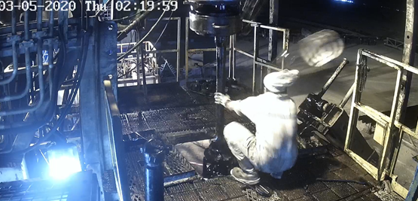
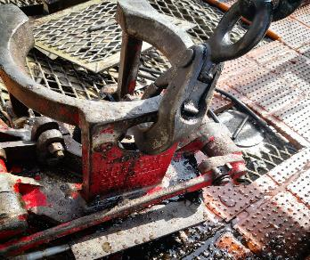
PDO Second Alert
Date: 05.03.2020 Incident title: HIPO#15
What happened?
At approximately 02:15 hrs on 5th of March 2020 roustabout was trying attach the winch line hook to the pneumatic slips to lift it for changing the air fittings. Driller was operating the winch from his cabin. When driller attempted to tension the winch line the hook released from the pneumatic slips and hit the roustabout on his face causing multiple wounds.
Your learning from this incident..
Always ensure the hook of the winch is properly attached to the load.
Always ensure people are cleared from line fire prior to tension the load lines.
Always review the work method prior to commence the task.
Always adhere to the SOP and safety precautions suggested in it.
Ensure hook is properly latched to the air slip before lifting
Target Audience: Drilling
Notes:
Ensure all dates and titles are input
A short description should be provided without mentioning names of contractors or individuals. You should include, what happened, to who (by job title) and what injuries this resulted in. Nothing more!
Four to five bullet points highlighting the main findings from the investigation. Remember the target audience is the front line staff so this should be written in simple terms in a way that everyone can understand.
The strap line should be the main point you want to get across
The images should be self explanatory, what went wrong (if you create a reconstruction please ensure you do not put people at risk) and below how it should be done.

Slide 2
Management self audit
Date: 05.03.2020 Incident title: HIPO#15
As a learning from this incident and ensure continual improvement all contract
managers must review their HSE HEMP against the questions asked below
Confirm the following:
Do you ensure people are cleared from line of fire before the lifting activity?
Do you ensure crew is adhering to the SOP?
Do you ensure method of dies change out is adequately covered int eh SOP?
Do you ensure the competence of the Driller in all activities that he needs to participate?
Do you ensure Driller has clear visibility over the activities on the Rig floor?
Do you ensure all modification on the Rig floor is with OEM approval?
* If the answer is NO to any of the above questions please ensure you take action to correct this finding.
Notes:
Ensure all dates and titles are input
Make a list of closed questions (only ‘yes’ or ‘no’ as an answer) to ask others if they have the same issues based on the management or HSE-MS failings or shortfalls identified in the investigation.
Imagine you have to audit other companies to see if they could have the same issues.
These questions should start with: Do you ensure…………………?

