Slide 1
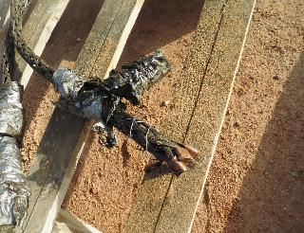
PDO Second Alert
Date: 09.03.2020 Incident title: HiPo#16
What happened?
The operation was installation of new drill line with mast in rigged up position. Traveling block was hanged by the crane and old drill line connected to the new drill line by Snake Grip tool. Driller on the brake started spooling up the line to the draw-work drum and at the last round of the spooling the new drill line slipped and disconnected from Snake grip tool and fall from 30m height onto the rig floor. The old drill line fell in between mast and draw works. Nobody inside Drop zone at the time of operation. Approximate weight of each portion of drill line is 90 kg.
Your learning from this incident..
Always Follow OEM recommendations for using the Snake Grip tool.
Always ensure to have complete tool kits before the start of the task.
Always Proper planning and risk assessment to be performed for the critical jobs.
Always perform the drill line installation job with the mast lay down.
Always adhere to Red & NO-GO zones.
Always use the right tool for the job
Target Audience: Drilling, Logistics, Operation, Engineering, Exploration & construction
Notes:
Ensure all dates and titles are input
A short description should be provided without mentioning names of contractors or individuals. You should include, what happened, to who (by job title) and what injuries this resulted in. Nothing more!
Four to five bullet points highlighting the main findings from the investigation. Remember the target audience is the front line staff so this should be written in simple terms in a way that everyone can understand.
The strap line should be the main point you want to get across
The images should be self explanatory, what went wrong (if you create a reconstruction please ensure you do not put people at risk) and below how it should be done.

Slide 2
Management self audit
Date: 09.03.2020 Incident title: HiPo#16
As a learning from this incident and ensure continual improvement all contract
managers must review their HSE HEMP against the questions asked below
Confirm the following:
Do you ensure that crews always use appropriate tools for the task?
Do you ensure critical spare parts are available and ordered ?
Do your ensure your site leadership adhering to OEM procedure?
Do you ensure risks & HEMP is communicated appropriately in the TBT ?
* If the answer is NO to any of the above questions please ensure you take action to correct this finding.
Notes:
Ensure all dates and titles are input
Make a list of closed questions (only ‘yes’ or ‘no’ as an answer) to ask others if they have the same issues based on the management or HSE-MS failings or shortfalls identified in the investigation.
Imagine you have to audit other companies to see if they could have the same issues.
These questions should start with: Do you ensure…………………?

