Slide 1
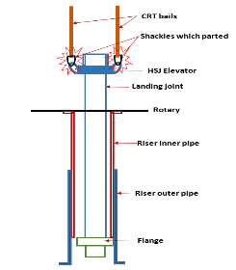
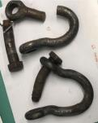
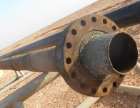
PDO Second Alert
Date: 17.03.2020 Incident title: HiPo#18
What happened?
After 9-5/8” casing cement job , Driller picked up landing joint and 2 floormen guided the landing joint to pass through the riser. Suddenly the landing Joint got stuck at bottom edge inner part of riser(riser consists of two telescopic pipes), both shackle used to connect the hydraulic single joint elevator (HSJE) to the Casing Running Tool (CRT) parted, resulting in landing joint assembly dropping and resting on the well head. No injuries to anyone.
Your learning from this incident..
Always ensure to set the Hook load limit as per the over pull limit of the particular lift.
Always ensure to pull through all obstructions slowly with proper communication.
Always ensure once obstructions are passed, STOP and ask crew to clear the rig floor before continuing to pull with close monitoring of the hook load.
Always ensure to keep only the minimum essential personnel in the Red Zone.
Always ensure while pulling tools at surface there is no margin for stretch like in drill pipe pulled from bottom.
Schematic diagram of the set up at time of incident
Broken shackles; impact on ring gasket and the Landing joint with flange
Watch your martin decker and set your limits correctly
Target Audience: Drilling, Logistics, Operation, Engineering, Exploration & construction
Notes:
Ensure all dates and titles are input
A short description should be provided without mentioning names of contractors or individuals. You should include, what happened, to who (by job title) and what injuries this resulted in. Nothing more!
Four to five bullet points highlighting the main findings from the investigation. Remember the target audience is the front line staff so this should be written in simple terms in a way that everyone can understand.
The strap line should be the main point you want to get across
The images should be self explanatory, what went wrong (if you create a reconstruction please ensure you do not put people at risk) and below how it should be done.

Slide 2
Management self audit
Date: 17.03.2020 Incident title: HiPo#18
As a learning from this incident and ensure continual improvement all contract
managers must review their HSE HEMP against the questions asked below
Confirm the following:
Do you ensure, the crew know the risk of stuck especially while pulling tools on surface?
Do you ensure, the crew knows the best operational practices when stuck is anticipated?
Do you ensure, the crew knows how to use the safety features in the system at any stage?
Do you ensure, the crew are carrying out work at rig floor with minimum exposure to red zone?
Do you ensure, the crew adherence to the Red Zone management?
* If the answer is NO to any of the above questions please ensure you take action to correct this finding.
Notes:
Ensure all dates and titles are input
Make a list of closed questions (only ‘yes’ or ‘no’ as an answer) to ask others if they have the same issues based on the management or HSE-MS failings or shortfalls identified in the investigation.
Imagine you have to audit other companies to see if they could have the same issues.
These questions should start with: Do you ensure…………………?

