Slide 1
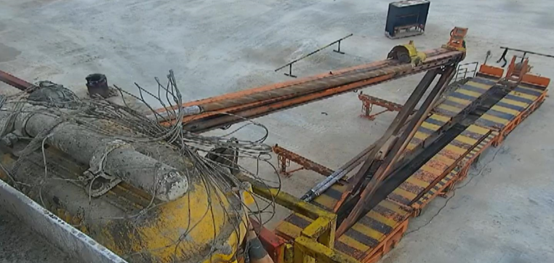
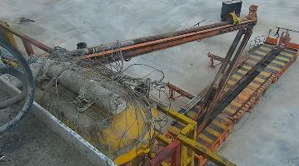
PDO Second Alert
Date: 20.03.2020 Incident title: HiPo#20
What happened?
On 20th march ,2020 at 01:30hrs, The operation was pick up and make up the 8-3/8” BHA, The RM operated the power catwalk and when the DC moved into the catwalk groove ,the DC was titled one side(Pin) out of groove. Accordingly when the power catwalk raised approximately 8.0 m, one of the floorman gave stop signal to the operator and the RM stop rising power catwalk. And then the rig manager has lowered the catwalk till about 6.8 meters while doing that the DC fall into the ground. Nobody was on the No-Go zone. No injury and no asset damage.
Your learning from this incident..
Always ensure only authorized personnel are operating the equipment.
Always ensure One floorman should observe the transportation of tubulars on power catwalk.
Always ensure all drill pipe in the center of the V-groove before pickup or lowering the drill pipe.
Always maintain proper communication between floorman and power catwalk operator.
Always respect the zone management.
Aalways intervene in any unsafe acts or unsafe condition.
Photo explaining what was done wrong
DC was not in the V-groove.
Photo explaining how it should be done right
DC in the center of the V-groove of power catwalk
Always ensure authorized personnel only operate the equipment
Target Audience: Drilling
Notes:
Ensure all dates and titles are input
A short description should be provided without mentioning names of contractors or individuals. You should include, what happened, to who (by job title) and what injuries this resulted in. Nothing more!
Four to five bullet points highlighting the main findings from the investigation. Remember the target audience is the front line staff so this should be written in simple terms in a way that everyone can understand.
The strap line should be the main point you want to get across
The images should be self explanatory, what went wrong (if you create a reconstruction please ensure you do not put people at risk) and below how it should be done.

Slide 2
Management self audit
Date: 20.03.2020 Incident title: HiPo#20
As a learning from this incident and ensure continual improvement all contract
managers must review their HSE HEMP against the questions asked below
Confirm the following:
Do you ensure supervisors supervising ongoing jobs/activities all the time?
Do you ensure that intervention is implemented in your sites?
Do you ensure person operating equipment competent and authorized?
Do you ensure crews using and following the SOPs?
Do you ensure LFI cascaded for all the employees even for new supervisors?
Do you ensure inaction process for all the employees even for new supervisors covered with privies learning?
* If the answer is NO to any of the above questions please ensure you take action to correct this finding.
Notes:
Ensure all dates and titles are input
Make a list of closed questions (only ‘yes’ or ‘no’ as an answer) to ask others if they have the same issues based on the management or HSE-MS failings or shortfalls identified in the investigation.
Imagine you have to audit other companies to see if they could have the same issues.
These questions should start with: Do you ensure…………………?

