Slide 1
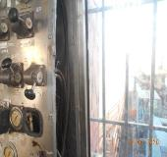
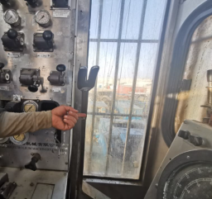
PDO Second Alert
Date: 24.03.2020 Incident title: HiPo#22
What happened?
During preparation for pressure test of BOP, Asst. Driller was lowering the traveling block with elevator by releasing the brakes. While doing so, the AD raised the brake handle lever which got stuck onto the driller console. As the traveling block lowered, AD tried to pull the brake handle lever, but by that time, the traveling block impacted on the rig floor handrail. No injury to personnel , no damages observed on the traveling block, rig floor or elevator.
Your learning from this incident..
Always ensure that the Assistant driller should only operate the brakes when he is supervised.
Always ensure that the driller console in the doghouse has enough clearance for proper functioning of the brake.
Always ensure that the emergency brake system works effectively in time of need.
Always ensure that all removed parts are fixed back in the equipment after maintenance.
Missing cover of the console caused stuck
Cover install in the Cabin
Always ensure that the pathway for the brake handle bar is unobstructed..
Target Audience: Drilling, Operation
Notes:
Ensure all dates and titles are input
A short description should be provided without mentioning names of contractors or individuals. You should include, what happened, to who (by job title) and what injuries this resulted in. Nothing more!
Four to five bullet points highlighting the main findings from the investigation. Remember the target audience is the front line staff so this should be written in simple terms in a way that everyone can understand.
The strap line should be the main point you want to get across
The images should be self explanatory, what went wrong (if you create a reconstruction please ensure you do not put people at risk) and below how it should be done.

Slide 2
Management self audit
Date: 24.03.2020 Incident title: HiPo#22
As a learning from this incident and ensure continual improvement all contract
managers must review their HSE HEMP against the questions asked below
Confirm the following:
Do you ensure Assistant Driller is not operating the brakes when he is unsupervised?
Do you ensure that the brake handle lever has an unobstructed pathway?
Do you ensure that MOC is in use for any change in SCE?
Do you ensure that proper function tests are carried out on critical equipment such as emergency brakes?
Do you ensure that assurance performed after maintenance for driller console?
Do you ensure that SCE log is visualize, updated and fully functioning?
If the answer is NO to any of the above questions please ensure you take action to correct this finding.
Notes:
Ensure all dates and titles are input
Make a list of closed questions (only ‘yes’ or ‘no’ as an answer) to ask others if they have the same issues based on the management or HSE-MS failings or shortfalls identified in the investigation.
Imagine you have to audit other companies to see if they could have the same issues.
These questions should start with: Do you ensure…………………?

