Slide 1
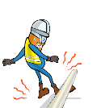
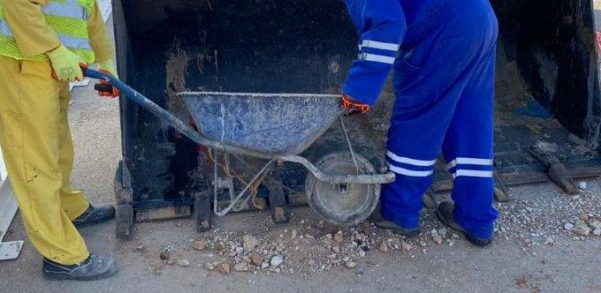
PDO Incident First Alert - Carillion
Incident Type | LTI#29 | Pattern | Struck by
Date / Time | 24.10.2020@09:50hrs | Directorate | UID
Location | Fahud | Dept | UIB
Target Audience
Construction, Operations, Logistics, Engineering , Exploration, Infrastructure & Drilling
What happened
While the Mason was assisting with moving excavated soil, his left foot got trapped between the wheel loaders front bucket teeth.
Mr. Musleh asks the questions of can it happen to you?
Do you ensure you are standing in a safe place?
How do you ensure that you are away from ‘Line of Fire’?
How do you ensure you identify all hazards before starting a task?
Please disseminate this LTI notification to your teams and use it in your tool box talks and HSE meetings and notice boards.
“This document is restricted and it is distributed for information purposes only and it shall not be shared with other than PDO employees and contracts without PDO permission”.

