Slide 1
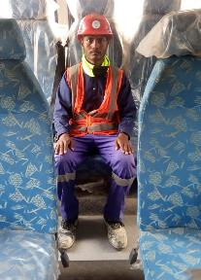
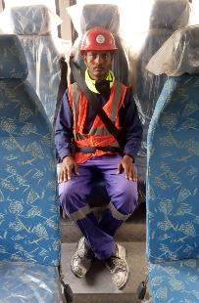
PDO Second Alert
Date: 01.04.2020 Incident title: LTI#05, Neck Injury
What happened?
While commuting supervisory Staffs from camp towards the site, the bus has entered through gate and followed through the diverted graded road. The bus driver was over-speeding did not noticed a recently constructed Speed hump and drove over it. This resulted into a civil foreman seated on the middle seat of the last row thrown upward and struck his head to the roof sustaining a neck injury.
Your learning from this incident.
Always fasten your seat belt in vehicle.
Ensure you intervene your co-passenger, if not fastening the seatbelt.
Driver to always pay attention on road conditions at all the time.
Driver to ensure than all passenger has fastened their seatbelt, prior starting the journey.
REMEMBER, Two Wrongs (No seat belt & Over-speeding) Never Makes a Right.
Target Audience: Drilling, Operations, Logistics, Engineering & Construction
Notes:
Ensure all dates and titles are input
A short description should be provided without mentioning names of contractors or individuals. You should include, what happened, to who (by job title) and what injuries this resulted in. Nothing more!
Four to five bullet points highlighting the main findings from the investigation. Remember the target audience is the front line staff so this should be written in simple terms in a way that everyone can understand.
The strap line should be the main point you want to get across
The images should be self explanatory, what went wrong (if you create a reconstruction please ensure you do not put people at risk) and below how it should be done.

Slide 2
Management self audit
Date: 01.04.2020 Incident title: LTI#05, Neck Injury
As a learning from this incident and ensure continual improvement all contract managers must review their HSE HEMP against the questions asked below
Confirm the following:
Do you ensure all passengers are fastening their seat belts?
Do you ensure all seat belts are in good working condition?
Do you ensure intervention is done when people do not wear seat belt?
Do you ensure driver is attentive (Speed hump, potholes, uneven surfaces) during the journey ?
Do you ensure Management of Change is communicated to all Stake holders?
Do your ensure compliance to relevant Standards/ Codes while making the change?
Do you ensure all bus drivers are assessed for their competency & familiarity of the road?
Do you ensure IVMS data has been closely monitored and consequence management has been imposed on Violators?
* If the answer is NO to any of the above questions please ensure you take action to correct this finding.
Notes:
Ensure all dates and titles are input
Make a list of closed questions (only ‘yes’ or ‘no’ as an answer) to ask others if they have the same issues based on the management or HSE-MS failings or shortfalls identified in the investigation.
Imagine you have to audit other companies to see if they could have the same issues.
These questions should start with: Do you ensure…………………?

