Slide 1
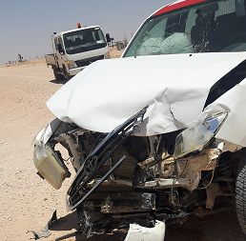
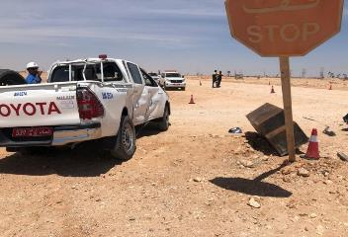
PDO Second Alert
Date: 13.04.2020 Incident title: HiPo#25
What happened?
Artificial lift commissioning engineer was on daily troubleshooting activities in Nimr area, when coming from intersection graded road attempted entering main graded road, causing collision with hoist 101 vehicle. The hoist vehicle could not stop or divert from the directions and hit on the right middle side of commissioning engineer vehicle flipping it to the side and then returned back to normal position. Both drivers were alone and did not sustain any injury however; drivers were taken to clinic for medical check and found fit.
Your learning from this incident..
Always focus on the external hazards on the road while driving.
Always stop at road junction if other vehicle has the right of way and there is a stop sign and ensure road is clear prior to enter main road.
Follow look around procedure and defensive driving behaviors while driving.
Always maintain concentration and focus while driving.
Always follow defensive driving procedure while driving
Target Audience: Drilling, Logistics, Operation, Engineering, Exploration & construction
Notes:
Ensure all dates and titles are input
A short description should be provided without mentioning names of contractors or individuals. You should include, what happened, to who (by job title) and what injuries this resulted in. Nothing more!
Four to five bullet points highlighting the main findings from the investigation. Remember the target audience is the front line staff so this should be written in simple terms in a way that everyone can understand.
The strap line should be the main point you want to get across
The images should be self explanatory, what went wrong (if you create a reconstruction please ensure you do not put people at risk) and below how it should be done.

Slide 2
Management self audit
Date: 13.04.2020 Incident title: HiPo#25
As a learning from this incident and ensure continual improvement all contract
managers must review their HSE HEMP against the questions asked below
Confirm the following:
Do you ensure that hazard awareness is understood by all drivers?
Do you ensure random evaluation eliminating poor Driving behavior?
Do you ensure conduct defensive driving campaigns for drivers refreshing driving skills?
Do you ensure drivers follow look around behavior especially while entering any junction, as a part of defensive driving procedure and guideline?
Do you ensure driving behavior hazard discussed and understood in morning meeting by all drivers?
* If the answer is NO to any of the above questions please ensure you take action to correct this finding.
Notes:
Ensure all dates and titles are input
Make a list of closed questions (only ‘yes’ or ‘no’ as an answer) to ask others if they have the same issues based on the management or HSE-MS failings or shortfalls identified in the investigation.
Imagine you have to audit other companies to see if they could have the same issues.
These questions should start with: Do you ensure…………………?

