Slide 1
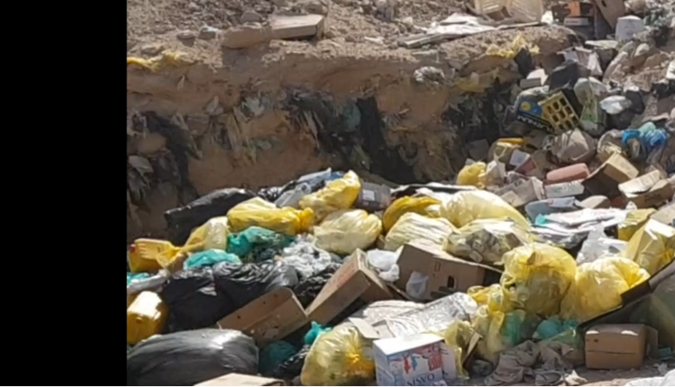
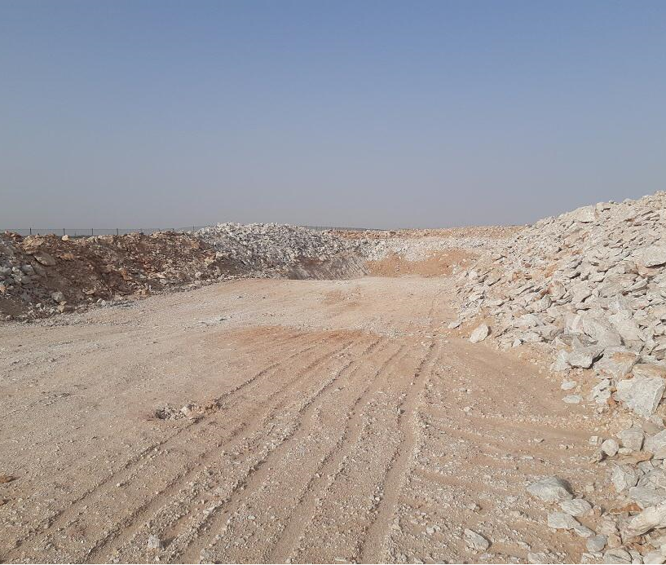
PDO Second Alert
Date: 25.04.2020 Incident title: HiPo#26a
What happened?
An unknown source ignited a fire in the uncovered nonhazardous waste trench at Bahja waste yard. The fire rapidly spread across the non-hazardous waste. This was extinguished, however, 2 days later the wood storage caught fire, causing further environmental impact to the area.
Your learning from this incident..
Always ensure that waste is disposed of properly, minimize waste, recycle were possible and stored in line with required standards.
Always ensure that any flammable or reflective materials are out of direct sunlight.
Always ensue that you know the emergency procedures in the event of a fire.
Always ensure you monitor areas that have potential for outbreaks of fire.
Always ensure that you are familiar with the hazards and risks in your workplace.
Waste – Reduce at Source, Recycle, Don’t Bury
Target Audience: Construction, Infrastructure, Utilities
Notes:
Ensure all dates and titles are input
A short description should be provided without mentioning names of contractors or individuals. You should include, what happened, to who (by job title) and what injuries this resulted in. Nothing more!
Four to five bullet points highlighting the main findings from the investigation. Remember the target audience is the front line staff so this should be written in simple terms in a way that everyone can understand.
The strap line should be the main point you want to get across
The images should be self explanatory, what went wrong (if you create a reconstruction please ensure you do not put people at risk) and below how it should be done.

Slide 2
Management self audit
Date: 25.04.2020 Incident title: HiPo#26a
As a learning from this incident and ensure continual improvement all contract
managers must review their HSE HEMP against the questions asked below
Confirm the following:
Do you ensure that you that SOP are reviewed and revised at least once a year?
Do you ensure that SOP are communicated to the operatives and followed?
Do you ensure that lateral learnings from any previous incidents/ have been communicated and implemented?
Do you ensure that waste yard is correctly designed as to minimize the risk fire is correctly segregated?
Do you ensure that suitable in-depth assurance audits are carried out?
Do you ensure that a fire watch and emergency plan are in place and practiced ?
* If the answer is NO to any of the above questions please ensure you take action to correct this finding.
Notes:
Ensure all dates and titles are input
Make a list of closed questions (only ‘yes’ or ‘no’ as an answer) to ask others if they have the same issues based on the management or HSE-MS failings or shortfalls identified in the investigation.
Imagine you have to audit other companies to see if they could have the same issues.
These questions should start with: Do you ensure…………………?

