Slide 1
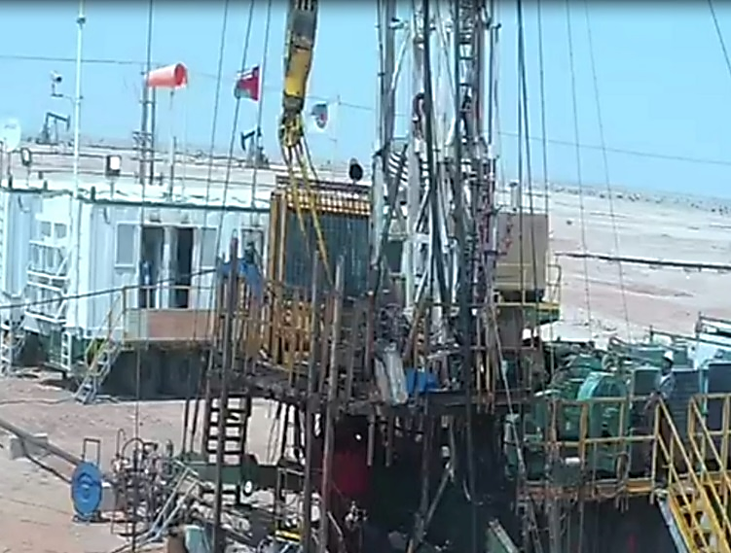
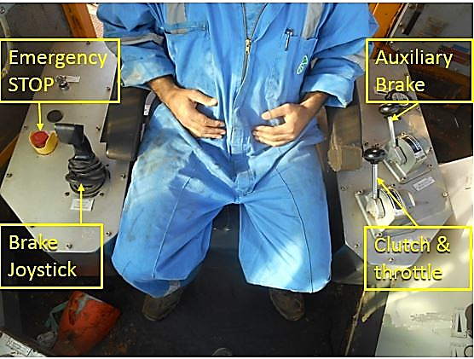
PDO Second Alert
Date: 26.04.2020 Incident title: HiPo#27a
What happened?
Operation was just start POOH tubing completion with ESP cable. On joint no-3 (at string weight of about 10 kdaN) the driller picked up about 3 m and stopped to cut the cable band. After cutting, he further attempted to pull out, but the travelling block started coming down. He tried to control the free fall by applying auxiliary brake. The block continued to descend, the elevator pulled down the hydraulic tong, and elevator came to rest on the hydraulic tong. Finally, the block stopped when the ACS got activated.
Your learning from this incident..
Always watch out for fatigue during Summer and Ramadhan.
Always ensure to take enough rest before joining the task.
Always ensure to exercise your Empowerment to Stop if you feel an y sign of fatigue.
Always ensure Driller and AD to practice a drill on how to react in such situations (apply ESD).
Watch-out for Fatigue Have Enough Rest
Target Audience: Drilling, Operations, Logistics, Engineering & Construction
Notes:
Ensure all dates and titles are input
A short description should be provided without mentioning names of contractors or individuals. You should include, what happened, to who (by job title) and what injuries this resulted in. Nothing more!
Four to five bullet points highlighting the main findings from the investigation. Remember the target audience is the front line staff so this should be written in simple terms in a way that everyone can understand.
The strap line should be the main point you want to get across
The images should be self explanatory, what went wrong (if you create a reconstruction please ensure you do not put people at risk) and below how it should be done.

Slide 2
Management self audit
Date: 26.04.2020 Incident title: HiPo#27a
As a learning from this incident and ensure continual improvement all contract
managers must review their HSE HEMP against the questions asked below
Confirm the following:
Do you ensure, the crew know the risk of fatigue and not having enough rest?
Do you ensure, the crew know they have the right to stop if they feel tired or unable to continue to work?
Do you ensure , the crew is taken necessary precautions during fasting?
Do you ensure , that planning is adequate during crisis, especially crew planning?
* If the answer is NO to any of the above questions please ensure you take action to correct this finding.
Notes:
Ensure all dates and titles are input
Make a list of closed questions (only ‘yes’ or ‘no’ as an answer) to ask others if they have the same issues based on the management or HSE-MS failings or shortfalls identified in the investigation.
Imagine you have to audit other companies to see if they could have the same issues.
These questions should start with: Do you ensure…………………?

