Slide 1
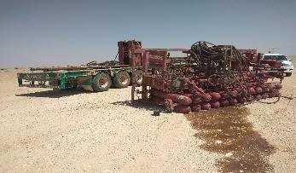
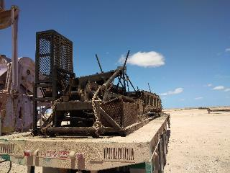
PDO Second Alert
Date: 27.04.2020 Incident title: HiPo#28
What happened?
During hoist move, the additional accumulator unit was on top of the flatbed trailer, secured by lashing belts. While vehicle took a sharp turn to the left in the T-junction of graded road, the load got released from its securing point and fell on the ground.
Your learning from this incident..
Always ensure to plan the job adequately.
Always ensure to have spare sets of lashing chains.
Always ensure to have supervision at old location to assure the secured load.
Always drive with in rig move SOP speed limit for rig move.
Always ensure to stop the vehicle at T junction.
All loads secured with chains to the trailer from both ends
Always ensure to secure the load with correct slings
Target Audience: Drilling, Operations, Logistics, Engineering & Construction
Notes:
Ensure all dates and titles are input
A short description should be provided without mentioning names of contractors or individuals. You should include, what happened, to who (by job title) and what injuries this resulted in. Nothing more!
Four to five bullet points highlighting the main findings from the investigation. Remember the target audience is the front line staff so this should be written in simple terms in a way that everyone can understand.
The strap line should be the main point you want to get across
The images should be self explanatory, what went wrong (if you create a reconstruction please ensure you do not put people at risk) and below how it should be done.

Slide 2
Management self audit
Date: 27.04.2020 Incident title: HiPo#28
As a learning from this incident and ensure continual improvement all contract
managers must review their HSE HEMP against the questions asked below
Confirm the following:
Do you ensure that the job is planned adequately?
Do you ensure that effective Learning from incident system in place?
Do you ensure that the loads are secured properly prior to move as per SP 2001?
Do you ensure that you have enough number of lashing chains for securing loads?
Do you ensure that the adequate supervision is available during rig move?
Do you ensure that the Learning from incidents shared with all contractors?
If the answer is NO to any of the above questions please ensure you take action to correct this finding.
Notes:
Ensure all dates and titles are input
Make a list of closed questions (only ‘yes’ or ‘no’ as an answer) to ask others if they have the same issues based on the management or HSE-MS failings or shortfalls identified in the investigation.
Imagine you have to audit other companies to see if they could have the same issues.
These questions should start with: Do you ensure…………………?

