Slide 1
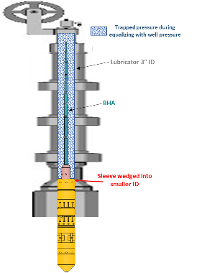
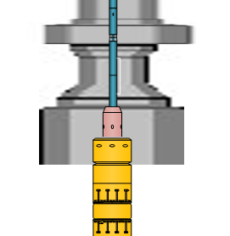
PDO Second Alert
Date: 03.05.2020 Incident title: HiPo#29
What happened?
While slickline lubricator was lowered, sudden release of tool string BHA (~200 kg) stuck inside the lubricator led to a fallen object (3.5 m height) on rig floor near to well center and release of trapped pressure (~11,000 kPa).
Your learning from this incident..
Full-bore lubricator with same ID is recommended.
Always have BHA against the stuffing box prior to changes in pressure in the lubricator (pressure test, equalization, opening the well, etc …)
Always prepare & review a stack-up diagram to avoid pulling bigger OD into smaller OD.
Ensure that SOP are regularly reviewed and updated to capture the learnings from incidents.
Interface Management by Site Supervisor is key to achieve alignment between different parties.
Target Audience: Drilling, Operations, Logistics, Engineering & Construction
Notes:
Ensure all dates and titles are input
A short description should be provided without mentioning names of contractors or individuals. You should include, what happened, to who (by job title) and what injuries this resulted in. Nothing more!
Four to five bullet points highlighting the main findings from the investigation. Remember the target audience is the front line staff so this should be written in simple terms in a way that everyone can understand.
The strap line should be the main point you want to get across
The images should be self explanatory, what went wrong (if you create a reconstruction please ensure you do not put people at risk) and below how it should be done.

Slide 2
Management self audit
Date: 03.05.2020 Incident title: HiPo#29
As a learning from this incident and ensure continual improvement all contract
managers must review their HSE HEMP against the questions asked below
Confirm the following:
Do you ensure your HEMP is reviewed regularly to implement leanings from previous incidents?
Do you ensure the SOP is provided and effectively communicated to all involved parties?
DO you ensure the SWI/Procedure provided at proper level of details to cover all possible scenarios?
Do you ensure the Interface management plan the work to ensure the correct equipment for the job are on site prior to the job commencement ?
* If the answer is NO to any of the above questions please ensure you take action to correct this finding.
Notes:
Ensure all dates and titles are input
Make a list of closed questions (only ‘yes’ or ‘no’ as an answer) to ask others if they have the same issues based on the management or HSE-MS failings or shortfalls identified in the investigation.
Imagine you have to audit other companies to see if they could have the same issues.
These questions should start with: Do you ensure…………………?

