Slide 1
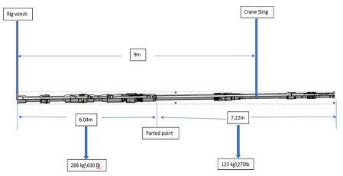
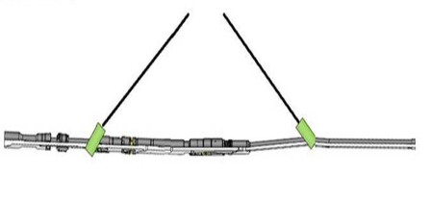
PDO Second Alert
Date: 30.04.2020 Incident title: HiPo#30
What happened?
During laying down of liner running tool (total length of Running tool was 12m) onto the cat walk using rig winch from top side and crane with sling from the lower part. A bend on the string was noticed, the string parted from the connection below the running tool. The running tool was at a height around 7m above the cat walk and the lower part length was about 6m. Each part hung and swung above the cat walk area. Catwalk area was clear of personnel. The two parts were laid down separately.
Your learning from this incident..
Always perform risk assessment prior to commencing a task Always prepare lift plan to address every lift.
Always involved all concerned parties into the pre-task safety discussion.
Always address all safety precautionary measures requested by PTW procedure.
Always STOP unsafe acts/conditions.
Always ensure tandem lift is given additional considerations.
Always fully address 10 questions for a safe lift prior to lifting.
Wrong: the tool being lifted in a tandem lift
Always ensure that long assemblies are lifted using a single crane method
Correct: the tool being lifted with a crane only
Target Audience: Drilling, Lifting
Notes:
Ensure all dates and titles are input
A short description should be provided without mentioning names of contractors or individuals. You should include, what happened, to who (by job title) and what injuries this resulted in. Nothing more!
Four to five bullet points highlighting the main findings from the investigation. Remember the target audience is the front line staff so this should be written in simple terms in a way that everyone can understand.
The strap line should be the main point you want to get across
The images should be self explanatory, what went wrong (if you create a reconstruction please ensure you do not put people at risk) and below how it should be done.

Slide 2
Management self audit
Date: 30.04.2020 Incident title: HiPo#30
As a learning from this incident and ensure continual improvement all contract
managers must review their HSE HEMP against the questions asked below
Confirm the following:
Do you ensure that all the hazards have been identified and controlled as ALARP?
Do you ensure that a consistent approach is applied across different rigs for the liner hanger assembly rigging method?
Do you ensure the lift plan adequately addresses all risks of the lift?
Do you ensure 10 questions for a safe lift are addressed fully prior to each lift?
Do you ensure that all non-routine lifts are supervised by a Lifting Supervisor?
Do you ensure that all key personnel involved in the preparation of lift plan are competent?
Do you ensure that all safety precautions are fully addressed prior to authorizing PTW?
Do you ensure that the procedures provide clear method statement?
Do you ensure that your lifting operations comply to PDO SP 2273?
* If the answer is NO to any of the above questions please ensure you take action to correct this finding.
Notes:
Ensure all dates and titles are input
Make a list of closed questions (only ‘yes’ or ‘no’ as an answer) to ask others if they have the same issues based on the management or HSE-MS failings or shortfalls identified in the investigation.
Imagine you have to audit other companies to see if they could have the same issues.
These questions should start with: Do you ensure…………………?

