Slide 1
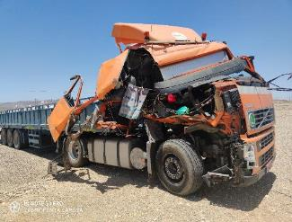
PDO Second Alert
Date: 13.05.2020 Incident title: HiPo#32
What happened?
A cargo vehicle on route to Fahud loaded with 22t of chemical bags was involved in a motor vehicle incident while travelling on the main carriage way. Another contractor tipper truck joined from a junction on the left, crossed the hatched markings, then merged onto the main highway into the path of the cargo vehicle. The cargo driver tried to avoid a collision by manoeuvring to the left but the front passenger side of the cab struck the rear driver side of the tipper truck. This resulted in minor damage to the tipper truck and severe damage to the cargo truck prime mover cab. There were no injuries sustained.
Your learning from this incident..
Always ensure the road is clear before exiting junctions.
Always ensure you do not leave acceleration / slip roads unless you have reached the required speed and it is clear to do so.
Always ensure you adjust your speed when faced with a hazard.
Always ensure you apply defensive driving techniques and read the road ahead Always ensure you are cautious of other 3rd party road users.
Always ensure you stop at stop signs / lines.
4
seconds
Leave space be safe
Target Audience: Drilling, Operations, Logistics, Exploration, Engineering & Construction

Slide 2
Management self audit
Date: 13.05.2020 Incident title: HiPo#32
As a learning from this incident and ensure continual improvement all contract
managers must review their HSE HEMP against the questions asked below
Confirm the following:
Do you ensure hazards presented by 3rd party vehicles are communicated to drivers on a regular basis?
Do you ensure drivers understand road sign compliance?
Do you ensure journey management process and procedures are implemented and followed?
Do you ensure drivers do not exceed driving hours without the required rest break?
Do you ensure sub contractors follow PDO specifications and standards?
* If the answer is NO to any of the above questions please ensure you take action to correct this finding.
Notes:
Ensure all dates and titles are input
Make a list of closed questions (only ‘yes’ or ‘no’ as an answer) to ask others if they have the same issues based on the management or HSE-MS failings or shortfalls identified in the investigation.
Imagine you have to audit other companies to see if they could have the same issues.
These questions should start with: Do you ensure…………………?

