Slide 1
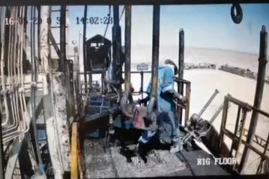
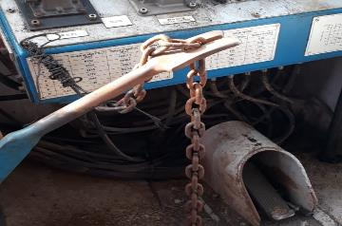
PDO Second Alert
Date: 16.05.2020 Incident title: HiPo#33
What happened?
At approximately 14:00 hrs on 16th of May 2020 Hoist 18 was in preparation
for Rig down and a Floorman and Roustabout came to the Rig floor for
moving out the handling tools. Whilst they were close to the center of the
floor, the travelling block started Slowly coming down and the elevator
touched on the back side of Roustabout. They immediately moved away
from the vicinity and the travelling block continued to descent and finally
rested at the off drillers ide of the Rig floor damaging a handrail.
Your learning from this incident..
Always ensure the brake handle is secured with chain whilst Driller and AD away from the brake.
Always ensure not to disconnect collision prevention systems during Rig down before the mast is fully lowered.
Always ensure the Assistant Driller is not left alone at the Drillers cabin.
Always ensure floor activities are performed under supervision.
Always ensure adequate communication and intervention.
Always ensure the Rig down commencement is approved by HSV.
Always ensure brake handle is secured with chain
Target Audience: Drilling, Logistics & Construction
Notes:
Ensure all dates and titles are input
A short description should be provided without mentioning names of contractors or individuals. You should include, what happened, to who (by job title) and what injuries this resulted in. Nothing more!
Four to five bullet points highlighting the main findings from the investigation. Remember the target audience is the front line staff so this should be written in simple terms in a way that everyone can understand.
The strap line should be the main point you want to get across
The images should be self explanatory, what went wrong (if you create a reconstruction please ensure you do not put people at risk) and below how it should be done.

Slide 2
Management self audit
Date: 16.05.2020 Incident title: HiPo#33
As a learning from this incident and ensure continual improvement all contract
managers must review their HSE HEMP against the questions asked below
Confirm the following:
Do you ensure that the brake arm is always secure with chain?
Do you ensure that the Assistant Driller is not left alone on the brake?
Do you ensure that nobody stepping on brake linkage to take shortcuts?
Do you ensure that the floor saver is disconnected after lowering the mast?
Do you ensure the SOP adequately addresses the connection / disconnection sequence of safety critical equipment?
Do you ensure the HSV gives approval for the critical activities like Rig down?
* If the answer is NO to any of the above questions please ensure you take action to correct this finding.
Notes:
Ensure all dates and titles are input
Make a list of closed questions (only ‘yes’ or ‘no’ as an answer) to ask others if they have the same issues based on the management or HSE-MS failings or shortfalls identified in the investigation.
Imagine you have to audit other companies to see if they could have the same issues.
These questions should start with: Do you ensure…………………?

