Slide 1
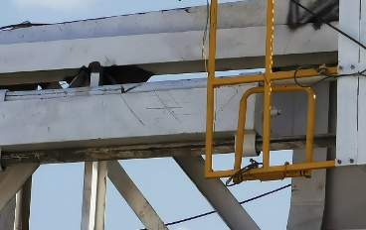
PDO Second Alert
Date: 16.05.2020 Incident title: HiPo#34
What happened?
Rig crew (AD, Floormen (3), Crane Operator) were working on the installation of the counterweight assembly on the mast. After having attached the bottom part of the assembly with the bolts, a Floorman moved to the right and positioned himself under the center of the counterweight assembly while it still was suspended. While attempting to adjust the assembly to fixing points, the assembly unexpectedly shifted towards the Floorman striking him.
Your learning from this incident..
Always exercise STOP Work Authority when safety is concerned.
Always use approved safe work practices & follow work instructions.
Always ensure adequate supervision of non-routine lifts.
Always perform risk assessment even for routine and simple tasks.
Always address 10 questions for a safe lift.
Always have an approved lift plan in place prior to a lift.
Always verify safety precautions prior to authorizing PTW.
Always ensure competency of task participants prior to performing the job.
Position of the Floorman at the time
of the event
Suspended
counterweight assembly
Always stay away from LOF (suspended load)
Target Audience: Lifting, Operations, Logistics, Engineering & Construction
Notes:
Ensure all dates and titles are input
A short description should be provided without mentioning names of contractors or individuals. You should include, what happened, to who (by job title) and what injuries this resulted in. Nothing more!
Four to five bullet points highlighting the main findings from the investigation. Remember the target audience is the front line staff so this should be written in simple terms in a way that everyone can understand.
The strap line should be the main point you want to get across
The images should be self explanatory, what went wrong (if you create a reconstruction please ensure you do not put people at risk) and below how it should be done.

Slide 2
Management self audit
Date: 16.05.2020 Incident title: HiPo#34
As a learning from this incident and ensure continual improvement all contract
managers must review their HSE HEMP against the questions asked below
Confirm the following:
Do you ensure that non-routine tasks are identified and prioritized accordingly?
Do you ensure that risk assessment is carried prior to non-routine tasks?
Do you ensure that lift plan is prepared and approved for each lift?
Do you ensure that PTW system is understood and properly implemented at the site?
Do you ensure that 10 questions for a safe lift are being addressed prior to each lift?
Do you ensure that the employees are empowered to use STOP Work Authority?
Do you ensure there is adequate supervision and leadership in day-to-day operations?
Do you ensure that staff is competent and adequately trained to perform lifting operations
Do you ensure that you perform the lift in accordance with SP 2273?
* If the answer is NO to any of the above questions please ensure you take action to correct this finding.
Notes:
Ensure all dates and titles are input
Make a list of closed questions (only ‘yes’ or ‘no’ as an answer) to ask others if they have the same issues based on the management or HSE-MS failings or shortfalls identified in the investigation.
Imagine you have to audit other companies to see if they could have the same issues.
These questions should start with: Do you ensure…………………?

