Slide 1
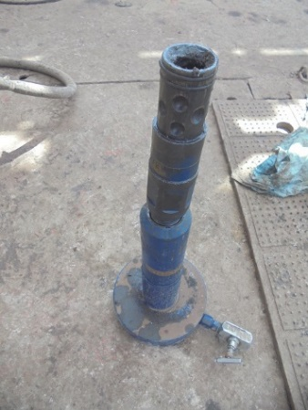
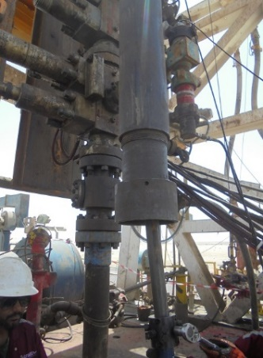
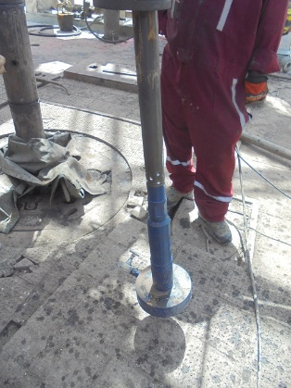
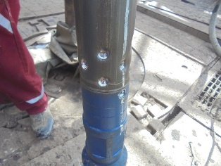
PDO Second Alert
Date: 17.05.2020 Incident title: HiPo#35
What happened?
While conducting a pull test for the coiled tubing connector . The pull test plate was rigged up and the dimple clamp was applied to be pull tested at 30,000lbs against the injector head riser above the CTU BOP stack. While conducting the pull test, the CTU operator pulled to approximately 24,000lbs, when the pull test plate clamp disengaged and the test plate dropped to the rig floor with the connector.
Your learning from this incident..
Coiled tubing pull test should always be conducted at 1 meter height.
Ensure adequate secondary retention for the test plate available and installed.
Dropped connector
Riser which was at 4.5 height
Pull test shall be performed at 01 meter height
CTU connector and pull test made at lower level
Target Audience: Drilling, Operations, Logistics, Engineering & Construction
Notes:
Ensure all dates and titles are input
A short description should be provided without mentioning names of contractors or individuals. You should include, what happened, to who (by job title) and what injuries this resulted in. Nothing more!
Four to five bullet points highlighting the main findings from the investigation. Remember the target audience is the front line staff so this should be written in simple terms in a way that everyone can understand.
The strap line should be the main point you want to get across
The images should be self explanatory, what went wrong (if you create a reconstruction please ensure you do not put people at risk) and below how it should be done.

Slide 2
Management self audit
Date: 17.05.2020 Incident title: HiPo#35
As a learning from this incident and ensure continual improvement all contract
managers must review their HSE HEMP against the questions asked below
Confirm the following:
Do you ensure that have SOPs for all critical operations?
Do you ensure that effective competency assessment is conducted for all people ?
Did you ensure secondary retention requirement is identified for all tools at height?
Do you ensure HEMP is regularly reviewed when ever critical incident occur or new contract with different operational requirement introduced?
* If the answer is NO to any of the above questions please ensure you take action to correct this finding.
Notes:
Ensure all dates and titles are input
Make a list of closed questions (only ‘yes’ or ‘no’ as an answer) to ask others if they have the same issues based on the management or HSE-MS failings or shortfalls identified in the investigation.
Imagine you have to audit other companies to see if they could have the same issues.
These questions should start with: Do you ensure…………………?

