Slide 1
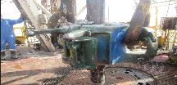
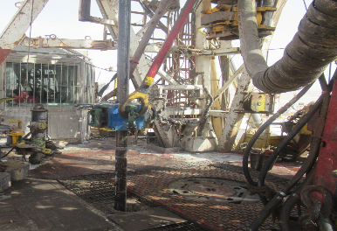
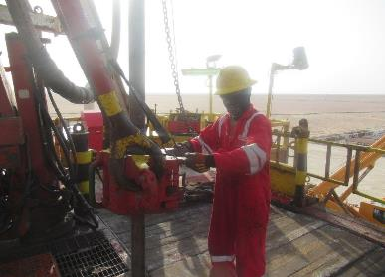
PDO Second Alert
Date: 07.06.2020 Incident title: HiPo#39
What happened?
The operation was running 4 1/2” VAMTOP completion using slip type elevator. When joint # 93 was picked up from mouse hole and hoisted 1 m above rotary table, the joint disconnected from elevator and dropped on the rig floor. The joint ended up on the vertical position beside the V-Door. supported by DS rig floor handrails. Nobody was injured.
Your learning from this incident..
Always Manually latch, the manual elevators around tubulars.
Always physically check that the elevators is properly latched around tubular before picking up the joint / stands.
Drillers/AD’s shall receive a clear confirmation signal from Floor man before pick up tubing joints.
Driller/AD should not be distracted while operating the brake.
Use empowerment to stop to intervene on unsafe acts.
Confirm that both latches of ‘manual’ elevators are engaged prior to picking up
Target Audience: Drilling, Logistics, Engineering & Construction
Notes:
Ensure all dates and titles are input
A short description should be provided without mentioning names of contractors or individuals. You should include, what happened, to who (by job title) and what injuries this resulted in. Nothing more!
Four to five bullet points highlighting the main findings from the investigation. Remember the target audience is the front line staff so this should be written in simple terms in a way that everyone can understand.
The strap line should be the main point you want to get across
The images should be self explanatory, what went wrong (if you create a reconstruction please ensure you do not put people at risk) and below how it should be done.

Slide 2
Management self audit
Date: 07.06.2020 Incident title: HiPo#39
As a learning from this incident and ensure continual improvement all contract
managers must review their HSE HEMP against the questions asked below
Confirm the following:
Do you ensure that your workforce close manual elevators ‘’manually’’ and physically verify that they are properly latched?
Do you ensure that your drillers/AD’s receive ‘’all clear signal’’ before they pick up tubing joints?
Do you ensure that your front line supervisors aware of their leadership duties and immediately intervene on substandard practices?
Do you have an assurance process to ensure that inappropriate practices are captured?
Do you ensure effective and close coaching and supervision when the AD on the brake?
* If the answer is NO to any of the above questions please ensure you take action to correct this finding.
Notes:
Ensure all dates and titles are input
Make a list of closed questions (only ‘yes’ or ‘no’ as an answer) to ask others if they have the same issues based on the management or HSE-MS failings or shortfalls identified in the investigation.
Imagine you have to audit other companies to see if they could have the same issues.
These questions should start with: Do you ensure…………………?

