Slide 1
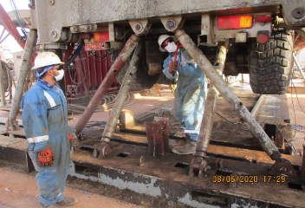
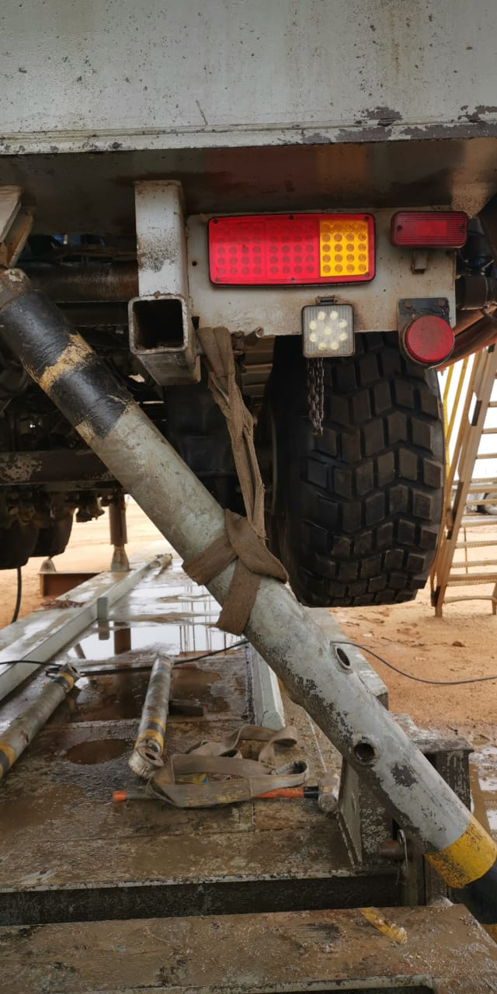
PDO Second Alert
Date: 06.06.2020 Incident title: HiPo#40
What happened?
At approximately 10:30 hrs during preparation for Rig down. A floor man was hammering the pin of the turn buckle to disconnect from the rig carrier. When the pin came off the turnbuckle dislodged from the pad eye causing it to drop approximately 1.5 meters and landed on the Floor-man’s left foot resulting swelling.
Your learning from this incident..
Always ensure your body parts are away from line of fire.
Always secure the potential dropped objects before dismantling.
Always ensure adequate supervision is provided at locations where activities are ongoing.
Always secure the turnbuckle before dismantling
Target Audience: Drilling, Operations, Logistics, Engineering, Exploration & Construction
Notes:
Ensure all dates and titles are input
A short description should be provided without mentioning names of contractors or individuals. You should include, what happened, to who (by job title) and what injuries this resulted in. Nothing more!
Four to five bullet points highlighting the main findings from the investigation. Remember the target audience is the front line staff so this should be written in simple terms in a way that everyone can understand.
The strap line should be the main point you want to get across
The images should be self explanatory, what went wrong (if you create a reconstruction please ensure you do not put people at risk) and below how it should be done.

Slide 2
Management self audit
Date: 06.06.2020 Incident title: HiPo#40
As a learning from this incident and ensure continual improvement all contract
managers must review their HSE HEMP against the questions asked below
Confirm the following:
Do you ensure the installation and dismantling of the turnbuckles are included in the SOP and HEMP?
Do you ensure the effective onsite supervision is provided?
Do you ensure the pins of the turn buckles are same size?
* If the answer is NO to any of the above questions please ensure you take action to correct this finding.
Notes:
Ensure all dates and titles are input
Make a list of closed questions (only ‘yes’ or ‘no’ as an answer) to ask others if they have the same issues based on the management or HSE-MS failings or shortfalls identified in the investigation.
Imagine you have to audit other companies to see if they could have the same issues.
These questions should start with: Do you ensure…………………?

