Slide 1
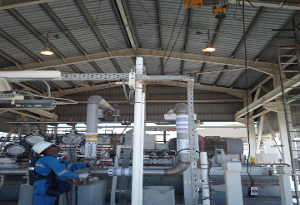
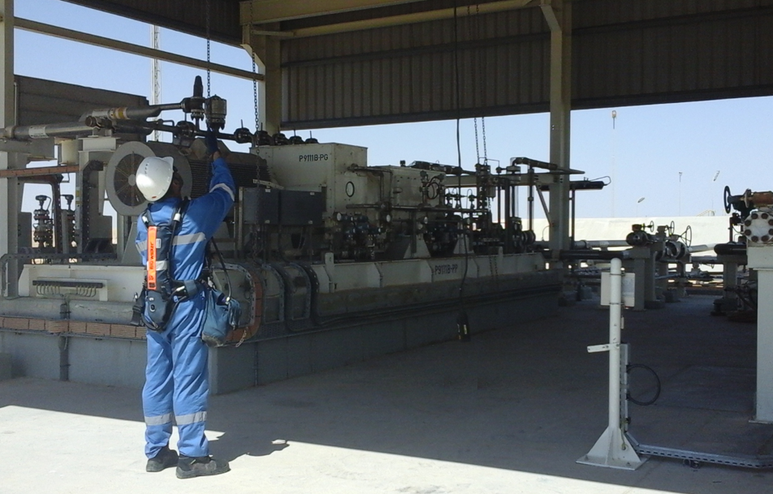
PDO Second Alert
Date: 09.04.2020 Incident title: HVL#08
What happened?
While moving the overhead crane by using the hand chain to the parking position, the cross trolley pulley chain link broke and fell down. Mechanical Technician used the hand chain to move the crane. He was pulling it at angle, No lifting activity on the crane nor load during movement. The Technician was standing 5 meter away from the pulley chain which fell down.
Your learning from this incident..
Always ensue only competent person shall operate lifting equipment.
Always ensure to follow the right lifting procedure.
Never work without proper supervision.
Always ensure to carryout risk assessment before start any task.
Ensure you have the correct training before operating any equipment.
Target Audience: Operations, Logistics, Workshops
Notes:
Ensure all dates and titles are input
A short description should be provided without mentioning names of contractors or individuals. You should include, what happened, to who (by job title) and what injuries this resulted in. Nothing more!
Four to five bullet points highlighting the main findings from the investigation. Remember the target audience is the front line staff so this should be written in simple terms in a way that everyone can understand.
The strap line should be the main point you want to get across
The images should be self explanatory, what went wrong (if you create a reconstruction please ensure you do not put people at risk) and below how it should be done.

Slide 2
Management self audit
Date: 09.04.2020 Incident title: HVL#08
As a learning from this incident and ensure continual improvement all contract
managers must review their HSE HEMP against the questions asked below
Confirm the following:
Do you ensure only authorized staff operate the equipment?
Do you ensure you carryout effective Lifting audits to drive compliance to SP 2273?
Do you ensure have a proper supervision for task at all times?
* If the answer is NO to any of the above questions please ensure you take action to correct this finding.
Notes:
Ensure all dates and titles are input
Make a list of closed questions (only ‘yes’ or ‘no’ as an answer) to ask others if they have the same issues based on the management or HSE-MS failings or shortfalls identified in the investigation.
Imagine you have to audit other companies to see if they could have the same issues.
These questions should start with: Do you ensure…………………?

