Slide 1
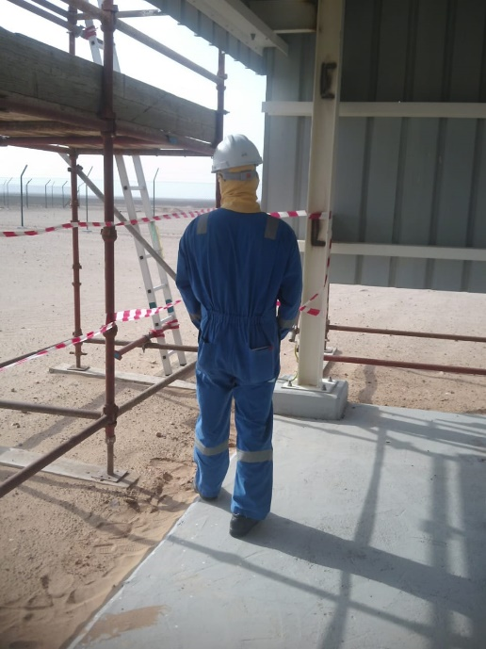
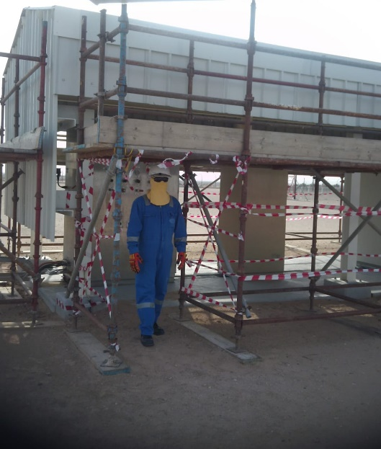
PDO Second Alert
Date: 13.04.2020 Incident title: LTI#06, L Ankle Injury
What happened?
An employee (Rigger) was taking rest inside a PDO permanent shed for well site instrumentation panel along with his two colleagues, during lunch break hours. After around 25 minutes into his rest period he decided to go for urinal without following the designated exit point and while walking he stepped along the edge of the concrete floor of the shed and twisted his left ankle causing fracture in heel bone.
Your learning from this incident..
Always use designated access/egress provided and do not take shortcuts.
Watch your steps and hazards around while walking.
Communicate and remind control measures such as designated access and egress of rest areas during TBT.
Shortcuts will cut short safety
Target Audience: Drilling, Operations, Logistics, Engineering & Construction

Slide 2
Management self audit
Date: 13.04.2020 Incident title: LTI#06, L Ankle Injury
As a learning from this incident and ensure continual improvement all contract
managers must review their HSE HEMP against the questions asked below
Confirm the following:
Do you ensure that your employees are reminded on the dangers of inattention to footings & surrounding?
Do you ensure that the use of designated access/egress is discussed in TBT/TRIC?
Do you ensure all hazards and risks are identified and mitigated when circumstances change such as Covid 19?
Do you ensure that you have mitigation plans in place to control the changes due to summer working process?
* If the answer is NO to any of the above questions please ensure you take action to correct this finding.

