Slide 1
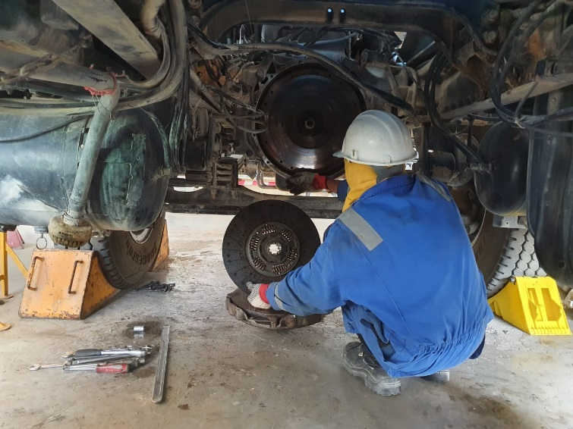
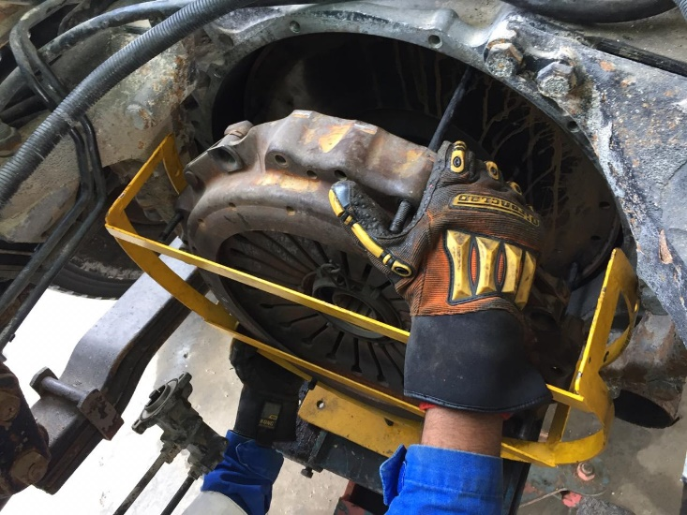
PDO Second Alert
Date: 22.04.2020 Incident title: LTI#07, Finger Injury
What happened?
An Auto-mechanic was removing the clutch disc from a Water tanker truck in P&E workshop with the help of his colleague. While doing this activity the clutch disc slipped and fell on his left hand middle finger tip causing a crush injury. He was given First aid at site and from hospital he was diagnosed with fracture in tip of the finger.
Your learning from this incident..
Always ensure heavy items are secured correctly
Always ensure your hands and fingers are out of “line of fire”.
Use Impact Resistant gloves while removing heavy parts of the vehicles.
Always use proper tools and follow safe methods/procedures for the task.
Use right tools and restraining techniques while removing heavy parts of vehicles
Target Audience: Drilling, Operations, Logistics, Engineering & Construction
Notes:
Ensure all dates and titles are input
A short description should be provided without mentioning names of contractors or individuals. You should include, what happened, to who (by job title) and what injuries this resulted in. Nothing more!
Four to five bullet points highlighting the main findings from the investigation. Remember the target audience is the front line staff so this should be written in simple terms in a way that everyone can understand.
The strap line should be the main point you want to get across
The images should be self explanatory, what went wrong (if you create a reconstruction please ensure you do not put people at risk) and below how it should be done.

Slide 2
Management self audit
Date: 22.04.2020 Incident title: LTI#07, Finger Injury
As a learning from this incident and ensure continual improvement all contract
managers must review their HSE HEMP against the questions asked below
Confirm the following:
Do you ensure that you have job specific methods/procedure/tools for P&E maintenance jobs?
Do you ensure that P&E jobs are supervised properly?
Do you ensure that your P&E mechanics are recruited, trained and Competency assessed for their trade specific knowledge and skills?
Do you ensure adequate PPE is provided and worn?
* If the answer is NO to any of the above questions please ensure you take action to correct this finding.
Notes:
Ensure all dates and titles are input
Make a list of closed questions (only ‘yes’ or ‘no’ as an answer) to ask others if they have the same issues based on the management or HSE-MS failings or shortfalls identified in the investigation.
Imagine you have to audit other companies to see if they could have the same issues.
These questions should start with: Do you ensure…………………?

