Slide 1
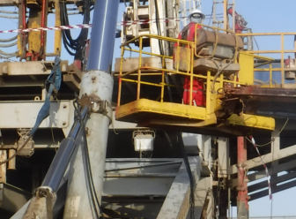
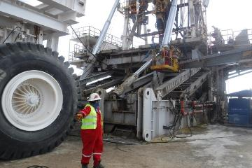
PDO Second Alert
Date: 07.05.2020 Incident title: LTI#08, Ribs Injury
What happened?
On Thursday 7th May 2020 at 01:30 am, activity was to remove the pin between the mast cylinder and support cylinder. Assistant Driller (AD) was using Mobile Elevated Working Platform (MEWP) for accessing the cylinder. Assistant Driller came out of basket while attempting to hammer the pin, he slipped striking his rib cage on beam.
After initial First Aid by the rig medic, Assistant Driller was taken to Ibri hospital by the rig ambulance.
X-ray revealed fracture of ribs.
Your learning from this incident..
Take time to correctly position MEWP for full use of basket.
Always adhere to working at height / MEWP Procedure requirements
Do not take the short cut. Any changes in job plan, stop and reassess.
Intervention must be used by all crew members at all times.
Always use lanyard and safety harness correctly with dedicated anchor point.
Do not climb out of MEWP basket while working at height
Target Audience: Drilling, Operations, Logistics, Engineering & Construction
Notes:
Ensure all dates and titles are input
A short description should be provided without mentioning names of contractors or individuals. You should include, what happened, to who (by job title) and what injuries this resulted in. Nothing more!
Four to five bullet points highlighting the main findings from the investigation. Remember the target audience is the front line staff so this should be written in simple terms in a way that everyone can understand.
The strap line should be the main point you want to get across
The images should be self explanatory, what went wrong (if you create a reconstruction please ensure you do not put people at risk) and below how it should be done.

Slide 2
Management self audit
Date: 07.05.2020 Incident title: LTI#08, Ribs Injury
As a learning from this incident and ensure continual improvement all contract
managers must review their HSE HEMP against the questions asked below
Confirm the following:
Do you ensure that crew are aware of Night Rig move no go activities?
Do you ensure that while working with MEWP at height, there is no requirement to climb from basket?
Do you ensure that night rig move activities are planned with your night supervisors?
Do you ensure that random self-verification of on going activities is done?
If the answer is NO to any of the above questions please ensure you take action to correct this finding.
Notes:
Ensure all dates and titles are input
Make a list of closed questions (only ‘yes’ or ‘no’ as an answer) to ask others if they have the same issues based on the management or HSE-MS failings or shortfalls identified in the investigation.
Imagine you have to audit other companies to see if they could have the same issues.
These questions should start with: Do you ensure…………………?

