Slide 1
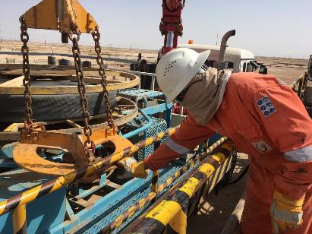
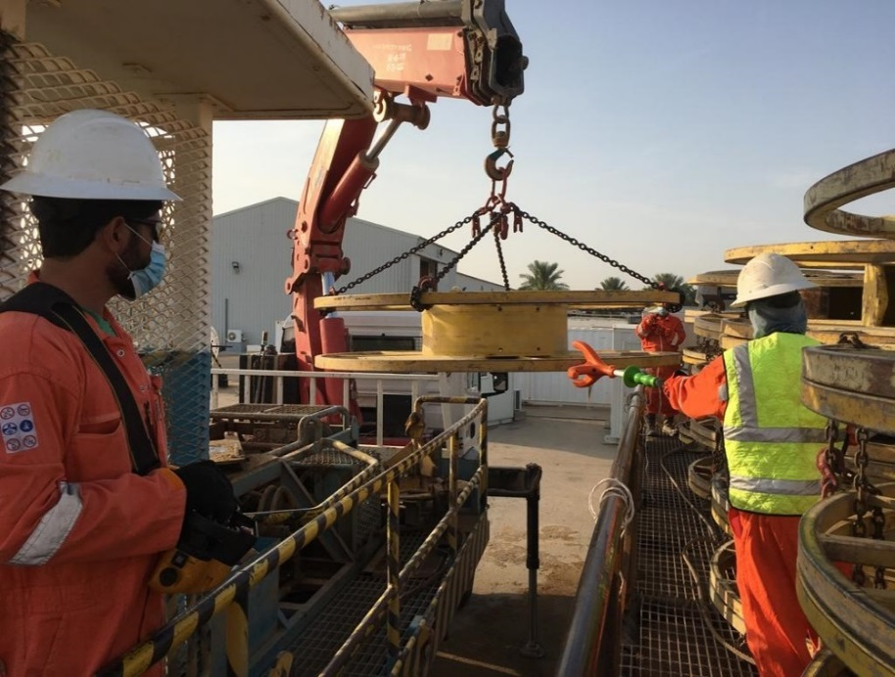
PDO Second Alert
Date: 17.05.2020 Incident title: LTI#10, Finger Injury
What happened?
On 17/05/2020 around 11:00 AM, Drill Water Site North (DWSN) Hose Deployment Unit (HDU) crew were performing drill water hose retrieval activity approximately 200 m outside Burhan West 42 location in the Qarn Alam area. While the HIAB truck operator was hoisting and moving the hose reel lifter attached to the loader crane, it got stuck in the handrails of the HIAB truck. The Assistant Technician who was standing on the trailer parked adjacent to the HIAB truck was trying to free the stuck hose reel lifter and in the process got his right hand index finger crushed between the hose reel lifter plate and the handrails of the HIAB truck.
Your learning from this incident..
Always ensure Supervisors, supervise the job.
Always, Identify and Communicate all hazards, their Risks & consequences prior to start work. Remind Stop Work Authority.
NEVER operate the controls and hoist the load until all personnel are at a safe distance.
Always INTERVENE, stop and correct unsafe acts and conditions.
Always ensure Hands –off methods are used to maneuver and manage hoisted loads or accessories.
Always ensure impact gloves are provided & used for activities with risk of pinch points.
Always keep Hands & Fingers away from line of fire
Target Audience: Drilling, Operations, Logistics, Engineering & Construction
Notes:
Ensure all dates and titles are input
A short description should be provided without mentioning names of contractors or individuals. You should include, what happened, to who (by job title) and what injuries this resulted in. Nothing more!
Four to five bullet points highlighting the main findings from the investigation. Remember the target audience is the front line staff so this should be written in simple terms in a way that everyone can understand.
The strap line should be the main point you want to get across
The images should be self explanatory, what went wrong (if you create a reconstruction please ensure you do not put people at risk) and below how it should be done.

Slide 2
Management self audit
Date: 17.05.2020 Incident title: LTI#10, Finger Injury
As a learning from this incident and ensure continual improvement all contract
managers must review their HSE HEMP against the questions asked below
Confirm the following:
Do you ensure that Hands-off tools are identified and provided for use at all your work sites?
Do you ensure that your staff use hands-off methods?
Do you ensure your supervisors and crew identify all hazards before starting a task?
Do you ensure your supervisors effectively communicate the hazards and risk before the task?
Do you ensure that all learnings from incidents (LFIs) are reviewed for relevance and appropriate actions raised and tracked for closure?
Do you ensure that L 2 & L 3 assurance audits verify for closure of actions from LFIs?
Do you ensure that relevant procedures, HEMP, SOPs & JSAs are reviewed and updated from Learnings from incidents?
Do you always ensure to review and update Procedures, SOP’s and JSA continually through TRIC review?
* If the answer is NO to any of the above questions please ensure you take action to correct this finding.
Notes:
Ensure all dates and titles are input
Make a list of closed questions (only ‘yes’ or ‘no’ as an answer) to ask others if they have the same issues based on the management or HSE-MS failings or shortfalls identified in the investigation.
Imagine you have to audit other companies to see if they could have the same issues.
These questions should start with: Do you ensure…………………?

