Slide 1
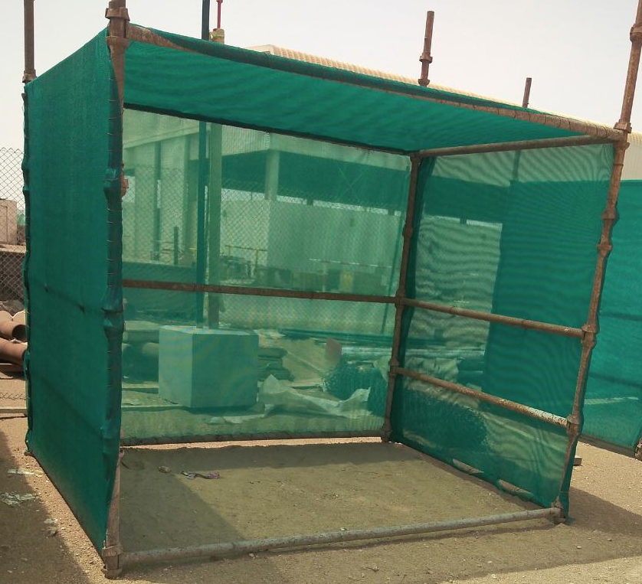

PDO Second Alert
Date: 13.06.2020 Incident title : LTI#11, R Leg Injury
What happened?
Scaffolding rest shelter toppled due to heavy wind as it
was not anchored. Scaffold standard of the rest shelter hit
right leg of a technician who was walking adjacent to it.
Your learning from this incident..
In high winds always use safe escape route.
Ensure rest shelters are properly secured.
Install resting shelter with proper anchoring to withstand any adverse weather condition.
Ensure proper site lay out and clearly earmark the walkway & traffic movement.
Ensure precautions for adverse whether !
Target Audience: Drilling, Operations, Logistics, Engineering & Construction
Notes:
Ensure all dates and titles are input
A short description should be provided without mentioning names of contractors or individuals. You should include, what happened, to who (by job title) and what injuries this resulted in. Nothing more!
Four to five bullet points highlighting the main findings from the investigation. Remember the target audience is the front line staff so this should be written in simple terms in a way that everyone can understand.
The strap line should be the main point you want to get across
The images should be self explanatory, what went wrong (if you create a reconstruction please ensure you do not put people at risk) and below how it should be done.

Slide 2
Management self audit
Date: 13.06.2020 Incident title : LTI#11, R Leg Injury
As a learning from this incident and ensure continual improvement all contract
managers must review their HSE HEMP against the questions asked below
Confirm the following:
Do you ensure that your supervisors are competent and experienced?
Do you ensure that temporary structures comply to standards or Risk assessed ?
Do you ensure that site walk cover questionnaire on Management of Change and Dynamic risk ?
Do you ensure that site management witness and encourage use of dynamic risk at site?
Do you ensure that management discuss BBS data and how sites are analyzing Near Miss events?
Do you ensure that Supervisor’s training include roles and responsibilities of management of change ?
* If the answer is NO to any of the above questions please ensure you take action to correct this finding.

