Slide 1
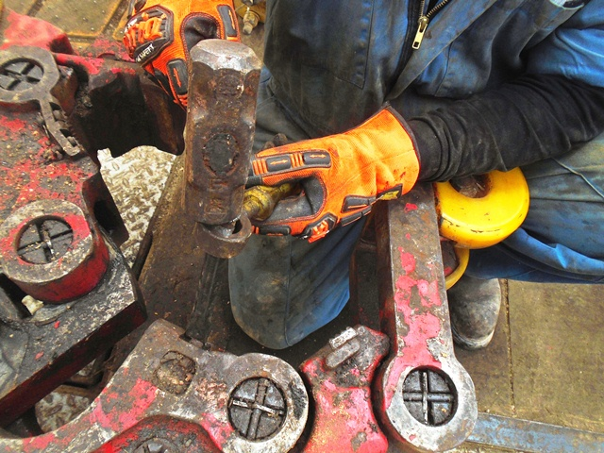
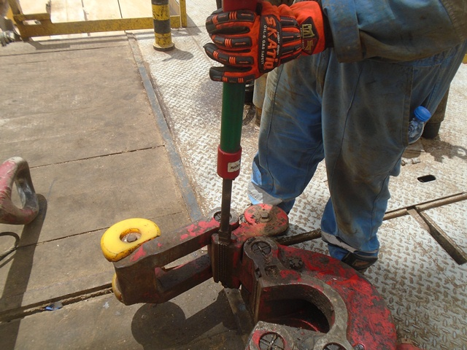
PDO Second Alert
Date: 03.07.2020 Incident title : LTI#14, R Thigh Injury
What happened?
At approximately 11:30 hrs on 03rd July 2020, While removing the manual tong dies using the die drive tool, one of the dies was stuck and the floor man used chisel with chisel holder to hammer the dies. While hammering, a small fragment from the die broke off and hit the floor man on his right thigh causing cut injury.
Your learning from this incident..
Always ensure that the dies that cannot be removed with die drive tool shall be taken to the workshop.
Always ensure not to use chisel and hammer for removing dies.
Always ensure that the body parts are not in the line of fire whilst hammering.
Always ensure SOP is correctly followed and no deviations.
Always intervene and correct the work method if deviation from the SOP is observed.
Don’t use chisel and hammer to remove tong dies
Target Audience: Drilling, Operations, Engineering, Construction & Logistics
Notes:
Ensure all dates and titles are input
A short description should be provided without mentioning names of contractors or individuals. You should include, what happened, to who (by job title) and what injuries this resulted in. Nothing more!
Four to five bullet points highlighting the main findings from the investigation. Remember the target audience is the front line staff so this should be written in simple terms in a way that everyone can understand.
The strap line should be the main point you want to get across
The images should be self explanatory, what went wrong (if you create a reconstruction please ensure you do not put people at risk) and below how it should be done.

Slide 2
Management self audit
Date: 03.07.2020 Incident title : LTI#14, R Thigh Injury
As a learning from this incident and ensure continual improvement all contract
managers must review their HSE HEMP against the questions asked below
Confirm the following:
Do you ensure that the tong dies are removed at workshop if the dies are stuck?
Do you ensure the floor crew are not using the chisel and hammer for removing dies?
Do you ensure your SOP clearly demands to take the tong to workshop if dies are stuck?
Do you ensure the crew members are not keeping the body parts in line of fire whilst changing dies?
Do you ensure LFI is adequately implemented?
* If the answer is NO to any of the above questions please ensure you take action to correct this finding.
Notes:
Ensure all dates and titles are input
Make a list of closed questions (only ‘yes’ or ‘no’ as an answer) to ask others if they have the same issues based on the management or HSE-MS failings or shortfalls identified in the investigation.
Imagine you have to audit other companies to see if they could have the same issues.
These questions should start with: Do you ensure…………………?

