Slide 1
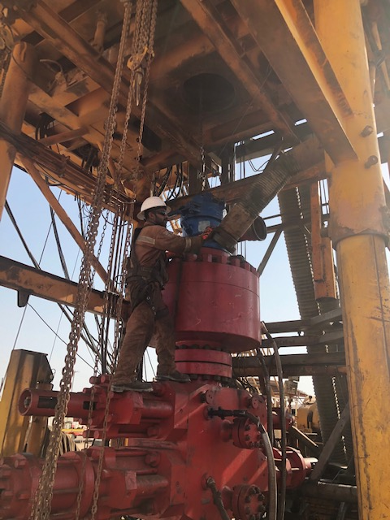
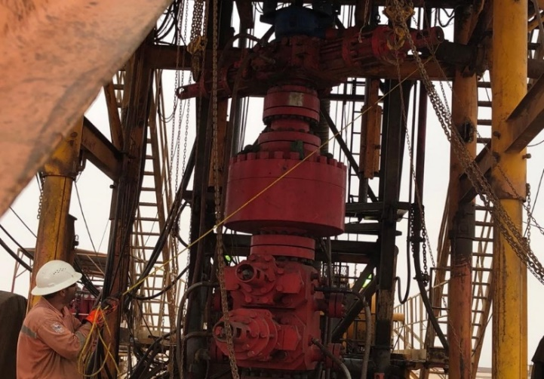
PDO Second Alert
Date: 15.07.2020 Incident title : LTI#15, L Hand Injury
What happened?
On 15th of July at 16:00 hrs; A Roustabout was standing on the pipe ram BOP at a height of 1.57 m shaking the flexible hose joint of the flowline (suspended by 2 web slings on a crane) in an attempt to slide the flowline out of the vent line connection on the shaker tank. The flowline came out from the vent line end and swung in the direction of the Roustabout, who lost his balance while trying to avoid it and fell down approx. 0.5 m, His fall was arrested by the fall arrester connected to his full body harness. He sustained fracture on his left hand little finger when he was struck by the wing nut of the flowline connection against the annular BOP body.
Your learning from this incident..
Always ensure to use approved Work Platforms or Mobile Elevated Work Platforms to work on BOP stack ( at height).
If face any problem, always ensure to Re-assess the task and effective controls to continue safely.
Always ensure to use Management of Change (including TRIC) process effectively to assure all new hazards identified and risks mitigated.
Always ensure to INTERVENE & STOP the activity if you feel unsafe situation.
Always ensure to use alternate methods to keep personnel safe from the line of fire and recorded in JSA / SOP.
Stay away from the line of fire of the potential swing of the suspended load
Target Audience: Drilling, Operations, Engineering, Construction & Logistics
Notes:
Ensure all dates and titles are input
A short description should be provided without mentioning names of contractors or individuals. You should include, what happened, to who (by job title) and what injuries this resulted in. Nothing more!
Four to five bullet points highlighting the main findings from the investigation. Remember the target audience is the front line staff so this should be written in simple terms in a way that everyone can understand.
The strap line should be the main point you want to get across
The images should be self explanatory, what went wrong (if you create a reconstruction please ensure you do not put people at risk) and below how it should be done.

Slide 2
Management self audit
Date: 15.07.2020 Incident title : LTI#15, L Hand Injury
As a learning from this incident and ensure continual improvement all contract
managers must review their HSE HEMP against the questions asked below
Confirm the following:
Do you ensure your supervisors and crew carried out Risk assessment and identify all hazards before starting any task?
Do you ensure your supervisors effectively communicate the hazards, risk & ensure the controls before the task?
Do you ensure that your MOC process is effectively implemented?
Do you ensure your supervisors identify the potential risk of fall from height for all activities?
Do you ensure that all learnings from incidents (LFIs) are reviewed for relevance and appropriate actions raised and tracked for closure and effectively communicated?
Do you always ensure to review and update Procedures, SOP’s and JSA continually through TRIC review & learning from incidents?
Do you ensure that your PTW covers all the worst case scenarios and their potential hazards during the planning phase?
* If the answer is NO to any of the above questions please ensure you take action to correct this finding.
Notes:
Ensure all dates and titles are input
Make a list of closed questions (only ‘yes’ or ‘no’ as an answer) to ask others if they have the same issues based on the management or HSE-MS failings or shortfalls identified in the investigation.
Imagine you have to audit other companies to see if they could have the same issues.
These questions should start with: Do you ensure…………………?

