Slide 1
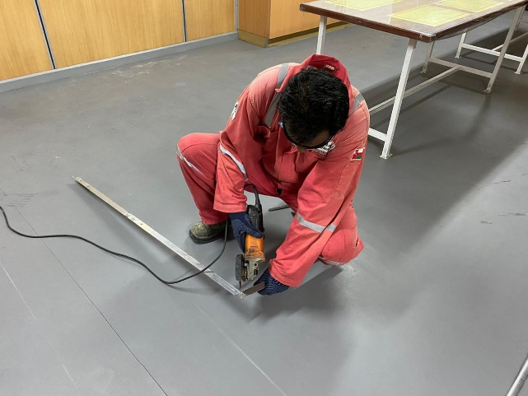
PDO Second Alert
Date: 21.08.2020 Incident title : LTI#16, Groin Area Injury
What happened?
On 21-08-2020 at 10:30 am, a third party Carpenter was working in the kitchen to install aluminum frame in the kitchen. He used angle grinder to cut an aluminum angle bar to fit on the frame. While doing so he used one hand to hold the material and second hand holding the grinder. Half way cutting through the aluminum angle bar, grinder lost contact with the aluminum piece and it came in contact with his genital area. First aid was administered by site medic and then transferred him to Haima hospital from where he was transferred to Nizwa hospital for further diagnosis and treatment.
Your learning from this incident..
Always ensure only approved and qualified contractor personnel work at site.
Always ensure PTW for non routine jobs is in place prior doing the job.
Always ensure appropriate tools are available for the task.
Always ensure your body is out from line of fire while using portable cutting equipment.
Always ensure supervisor is available and is supervising the job.
Ensure that all employees are in compliance with “out of sight” work requirement.
Ensure designated work place is used for cutting / grinding activity
Target Audience: Drilling, Operations, Engineering, Construction & Logistics
Notes:
Ensure all dates and titles are input
A short description should be provided without mentioning names of contractors or individuals. You should include, what happened, to who (by job title) and what injuries this resulted in. Nothing more!
Four to five bullet points highlighting the main findings from the investigation. Remember the target audience is the front line staff so this should be written in simple terms in a way that everyone can understand.
The strap line should be the main point you want to get across
The images should be self explanatory, what went wrong (if you create a reconstruction please ensure you do not put people at risk) and below how it should be done.

Slide 2
Management self audit
Date: 21.08.2020 Incident title : LTI#16, Groin Area Injury
As a learning from this incident and ensure continual improvement all contract
managers must review their HSE HEMP against the questions asked below
Confirm the following:
Do you ensure that 3rd party companies hired to work on your site provided are approved and qualified contracted personnel?
Do you ensure that PTW is applied for any contractor work at the site?
Do you ensure designated area is assigned for cutting and grinding activity?
Do you ensure that a supervisor is available and supervising the contractor work?
Do you ensure that TBT/TRIC or JSA are discussed with the contractor employees before starting their tasks?
* If the answer is NO to any of the above questions please ensure you take action to correct this finding.
Notes:
Ensure all dates and titles are input
Make a list of closed questions (only ‘yes’ or ‘no’ as an answer) to ask others if they have the same issues based on the management or HSE-MS failings or shortfalls identified in the investigation.
Imagine you have to audit other companies to see if they could have the same issues.
These questions should start with: Do you ensure…………………?

