Slide 1
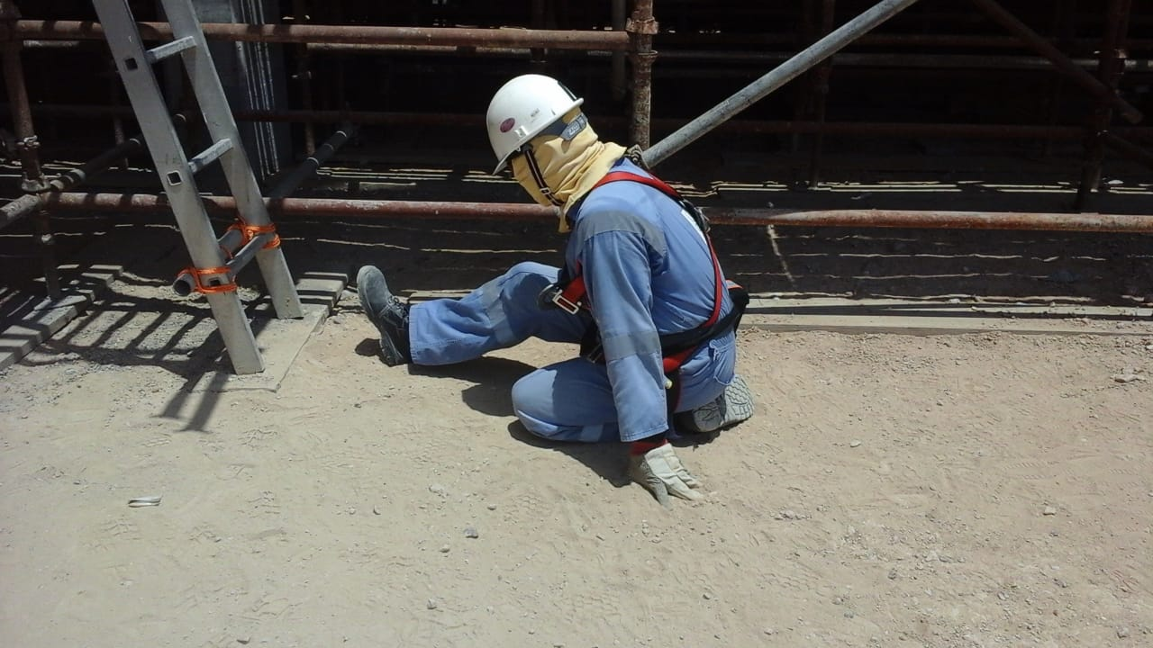
PDO Second Alert
Date: 29.07.2020 Incident title : LTI#18, Knee Injury
What happened?
A carpenter felt dizzy while working on a scaffold platform of height 1.8 meters and while coming down he slipped from the last few rungs of the ladder. The carpenter complained of leg pain, he was referred to hospital where he was diagnosed with a minor fracture in knee joint.
Your learning from this incident..
If injured or unwell whilst working at height, rest on work platform if safe to do so and contact emergency number if necessary.
Inform your supervisor if you feel unwell prior to work at height.
Stay hydrated while working in hot summer.
If you are unwell /injured while work at height seek help and stay safe.
Target Audience: Construction, Operations, Logistics, Engineering , Exploration & Drilling

Slide 2
Management self audit
Date: 29.07.2020 Incident title : LTI#18, Knee Injury
As a learning from this incident and ensure continual improvement all contract
managers must review their HSE HEMP against the questions asked below
Confirm the following:
Do you ensure that the employees working during hot Summer months are following Heat Stress management precautions especially taking electrolyte drinks?
Does your Work at Height procedure and HEMP address what to do and not do in the event some one injured or unwell while working at height?
Do you ensure that evacuation drills are conducted with the scenario “Rescue of employee who is unwell/ injured while working at height”?
* If the answer is NO to any of the above questions please ensure you take action to correct this finding.
Notes:
Ensure all dates and titles are input
Make a list of closed questions (only ‘yes’ or ‘no’ as an answer) to ask others if they have the same issues based on the management or HSE-MS failings or shortfalls identified in the investigation.
Imagine you have to audit other companies to see if they could have the same issues.
These questions should start with: Do you ensure…………………?

