Slide 1
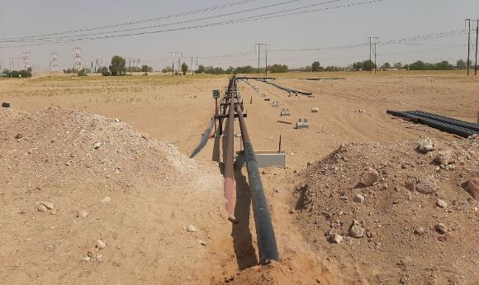
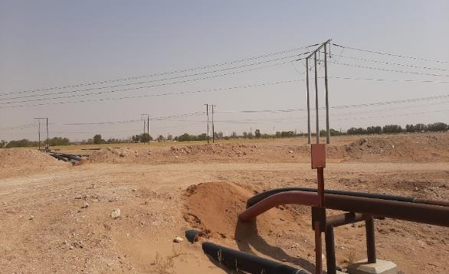
PDO Second Alert
Date: 12.06.2020 Incident title: HiPo#44
What happened?
On 12th of June 2020 Approximately 10:30 hrs at Fahud - North East MLPS while PDO pipeline engineers were conducting a routine site visit, they noticed a newly installed 6’’ flow line crossing over Fahud–Nahda main oil line and right of way (ROW). PDO Fahud team got the information that one of the contractor has constructed the new 6’’ flow line without NOC (No objection Certificate) from UIPT45.
Your learning from this incident..
Always ensure that your surveying details are accurate
Always conduct a site visit prior to apply for a new permit.
Always ensure that all pipelines crossings need to be discussed with PDO pipe line engineer.
Always ensure that a line walk to be done with construction team.
Always ensure you are approaching the client for any doubts in the sign boards or directions.
Always ensure that your drawings are accurate before getting the approvals.
New Flow line crossing the MOL and ROW without NOC from UIPT45
Remember !
Construction on right of ways (ROW) requires an NOC !
As per PR 1817, MOC from UIPT45 is always required before installing a flow line near the MOL .
Target Audience: Operation, Engineering & construction
Notes:
Ensure all dates and titles are input
A short description should be provided without mentioning names of contractors or individuals. You should include, what happened, to who (by job title) and what injuries this resulted in. Nothing more!
Four to five bullet points highlighting the main findings from the investigation. Remember the target audience is the front line staff so this should be written in simple terms in a way that everyone can understand.
The strap line should be the main point you want to get across
The images should be self explanatory, what went wrong (if you create a reconstruction please ensure you do not put people at risk) and below how it should be done.

Slide 2
Management self audit
Date: 12.06.2020 Incident title: HiPo#44
As a learning from this incident and ensure continual improvement all contract
managers must review their HSE HEMP/SOP’s against the questions asked below
Confirm the following:
Do you ensure that the site team is always conducting regular site visits to ensure the compliance of the Procedures ?
Do you ensure always effective communication within the team Members?
Do you ensure that your site Management are verifying the documents before getting the client approvals?
Do you ensure that you have identified all the potential hazards before starting the task?
Do you ensure that your PTWHs & PTWA are cross checking the compliance of their PTW documents and attachments?
Do you ensure that the site teams are having a proper guidelines to identify any potential failures?
* If the answer is NO to any of the above questions please ensure you take action to correct this finding.
Notes:
Ensure all dates and titles are input
Make a list of closed questions (only ‘yes’ or ‘no’ as an answer) to ask others if they have the same issues based on the management or HSE-MS failings or shortfalls identified in the investigation.
Imagine you have to audit other companies to see if they could have the same issues.
These questions should start with: Do you ensure…………………?

